Slide 1
The Rotary Foundation
Our world --- not as it is, but as it could be…
Notes:
Hello and welcome to Rotary Foundation 101, a very basic and introductory lesson on The Rotary Foundation. (TRF).
When I took my first French class, I knew a few Phrases like “hors D’oeuvres and déjà vu, and pomme frites . Everything else was Greek to me. This session will assume that you know about as much about TRF as I did about French that first day in class. My name is Patrick Carlton and I am the Rotary International Foundation Mentor for Southern Nevada. Let’s begin.

Slide 2
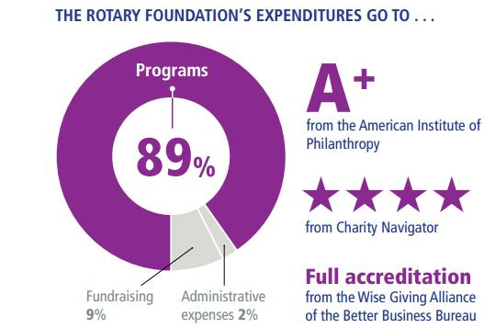
Charity Rating Services
Notes:
TRF is a highly respected charitable foundation, annually receiving high marks from three of the most important “watchdog organizations” that track the behavior of foundations. TRF is “top drawer.” As you see, 89% of funds received go to support charitable programs of the type we have been discussing. Only 11% of the money is employed in fundraising and for administrative expenses. Not bad at all!

Slide 3


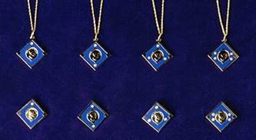
Donating to The Rotary Foundation
Recognition
Paul Harris Fellow
  $1,000 to The Rotary Foundation
    One-time gift
    Over time
    Combination of dollars and recognition points
Paul Harris Society
  Commitment to make gift annually
  $1,000 every year
  Annual Fund, PolioPlus or approved global grant
Major Donor
  $10,000 or more in actual dollars given
  Four Major Donor levels recognizes
    $10,000, $25,000 , $50,000 $100,000
Notes:
Here are several ways to recognize member support of the foundation. The Paul Harris Fellow program, established in 1957, recognizes members who, either at “one fell swoop” or over a period of time, donate $1000 to TRF. They are honored with a special certificate and a lapel pin which announces to other Rotarians that the wearer is “all in” for the Foundation. Those members who agree to make an annual contribution of at least $1000 to TRF are named members of the Paul Harris Society. In District 5300 Jan Carlton has served as the Coordinator of the Society since just after its creation in 2005. I had the honor of serving as her Co-Coordinator for one year. Members who donate $10,000 or more to TRF are honored with the title of Major Donor at four giving levels shown here.

Slide 4

Donating to The Rotary Foundation
Recognition
Arch C. Klumph Society (AKS)
  $250,000 or more to Annual Fund, PolioPlus or Endowment Fund
  Three AKS Levels recognized: $250k; $500k; $1 million
Notes:
There are support opportunities both for those with modest financial capacity as well as Las Vegas “high rollers.” Those donating $250,000 or more are named members of the Arch Klumpf Society. There are three AKS giving levels. $250,000; $500k; and $1 million. (Three diamonds) Members have their family photos posted in a special display at Rotary Headquarters in Evanston, Illinois and are invited to a special presentation ceremony honoring their philanthropy. Very nice event!

Slide 5
Paul Harris Society

Slide 6
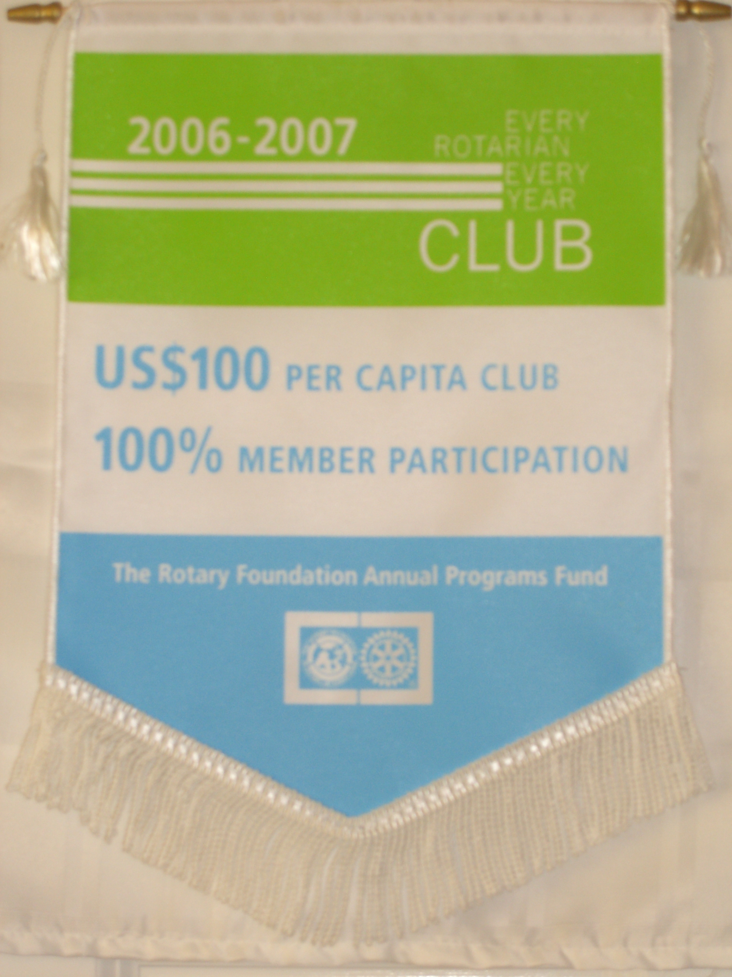


Club Recognitions
Every Rotarian Every Year Club
Every member makes a donation and average donations are $100 per member.
100 % Sustaining Member Club
Every member makes a donation and every member’s donation is at least $100.
100 % Paul Harris Fellow Club
Every member of the club is a Paul Harris Fellow at the time of the application.
Notes:
EREY-Avg donations from club equal $100 per member. 100% Sustaining Member Club. Every member contributes at least $100 to TRF. There are 7 100% PHF clubs in 5300. Five of them are in Nevada. (Southwest, North LV, Central, Las Vegas, and Las Vegas West.)

Slide 7
100% Paul Harris Fellow Clubs – District 5300 – 14 Clubs
Notes:
Report supplied by the Contact Center.

Slide 8
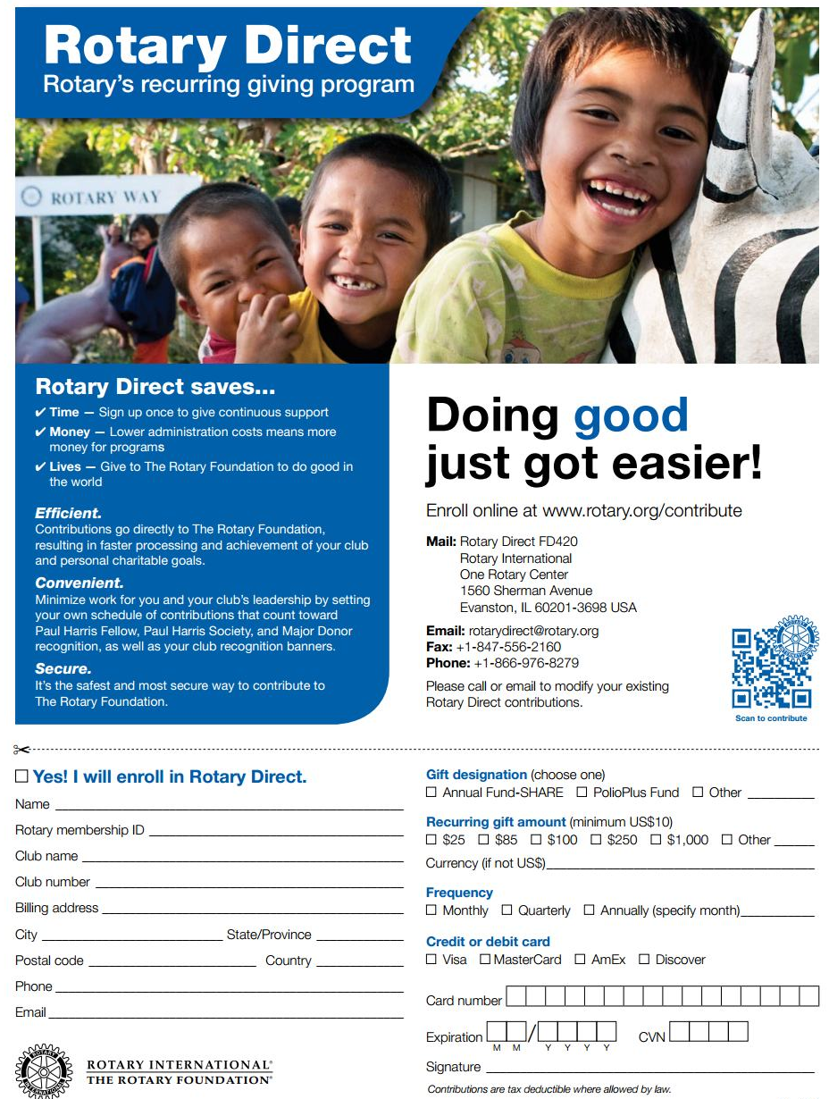
Rotary Direct
Monthly
Quarterly
or Annual
Recurring
Contributions:
TRF makes it
Automatic!
Notes:
Looking for an easy way to contribute? Consider signing up for Rotary Direct, Rotary’s recurring giving program, with either your credit or debit card. Pick a fund, either the Annual Fund or PolioPlus Fund, or both. Select your frequency- monthly, quarterly or annually. That way you don’t have to tie a string around your finger, or some other portion of your anatomy!

Slide 9
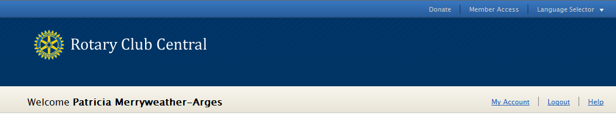
Who can enter goals?
CLUB LEVEL
President
Secretary
Treasurer
Foundation Chair
Membership Chair
Executive Secretary
DISTRICT LEVEL
District Governor
*Assistant Governors
Committee Chairs
Executive Secretary
Notes:
Everyone in the club can view goals, but who specifically can enter and edit goals?
(CLICK)
At the club level, the president, secretary, treasurer, Foundation chair, membership chair, and executive secretary can all enter goals for the year they are in office?
(CLICK)
At the district level, the district governor, committee chairs, and district executive secretary can view and edit the goals for all clubs in the district for their year. The assistant governors may view all goals but only edit the goals for the clubs in their club group. This is so district officers can assist a club with reporting its goals in case the club is unable to do so. When goals are set on behalf of a club, an automated email is generated and sent to the club president listing the goal change and who made the change.
Ideally, club officers will enter their club’s goals during their elect year.
(CLICK)
However, current, incoming, and immediate past officers can view all year tabs, and edit goals and achievements for their own year at any time (even after their year is over).
So, let’s take a look at two examples of a club entering a goal.

Slide 10
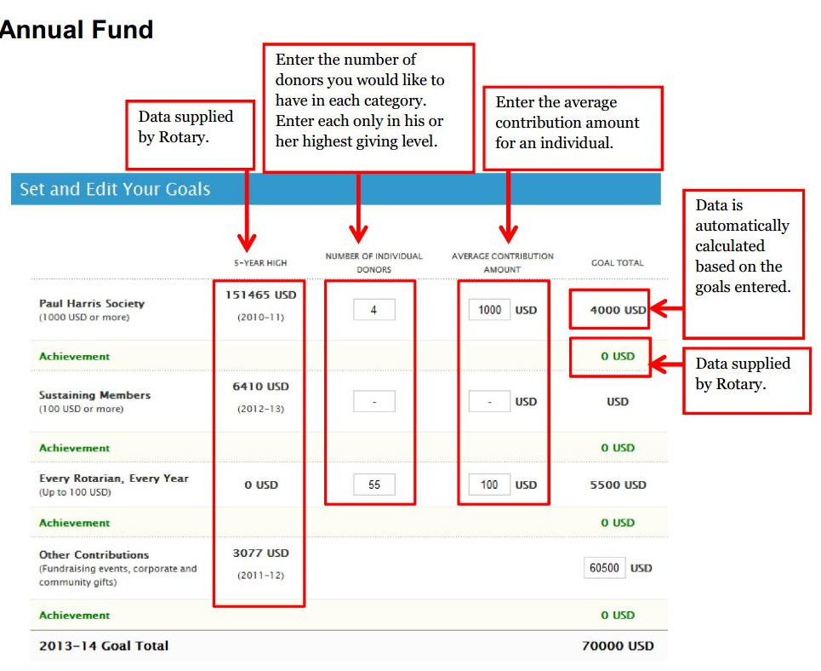
Goal Setting In Rotary Club Central
Notes:
Below the Annual Fund trends are the three main goals for Foundation giving:
-The Annual Fund is broken out by Paul Harris Society, Sustaining Members, EREY, and other contributions.
-Then we have PolioPlus.
-And last we have Major Gifts and Endowment Fund, which includes Major Gifts, Bequest Society, and Benefactors.
In this example we’ll be entering a goal for Annual Fund, on the Foundation Giving tab.
Anyone who can edit goals in that particular year will see an “EDIT” button.
(CLICK)
Everyone else will see “VIEW” which allows them to see the goals in more detail, but not add or change goals and achievements.
So, let’s click “EDIT”

Slide 11
Useful Reports
Reports
  Your personal Donor History Report
  Club Fundraising Analysis
  Club Recognition Summary (CRS)
  EREY, Sustaining Member, and Paul Harris Society Eligibility Report
  PolioPlus Contribution Report

Slide 12
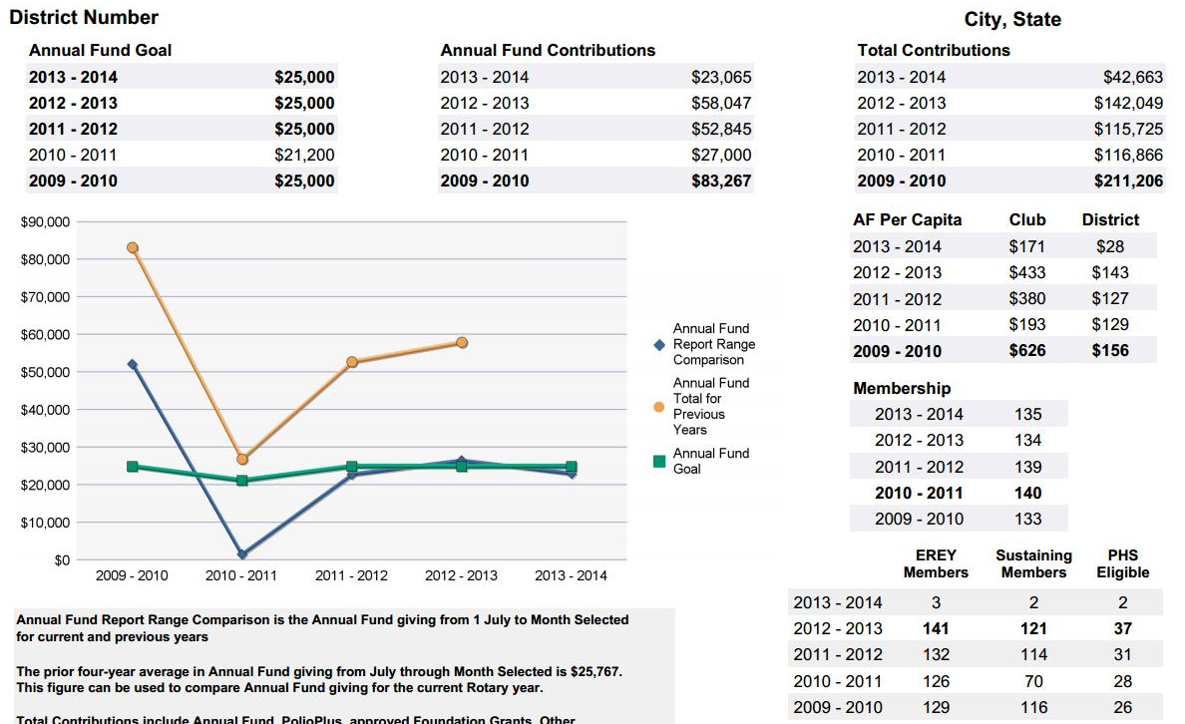
Club Fundraising Analysis
  5 Rotary year dashboard of Annual Fund goals, giving and recognition totals
  Use to set goals which are submitted through Rotary Club Central
Notes:
Participation & transparency
learn from prior years (what to do & what not to do)
involve in goal setting & fundraising
reminders (gave last year but not yet this year)

Slide 13
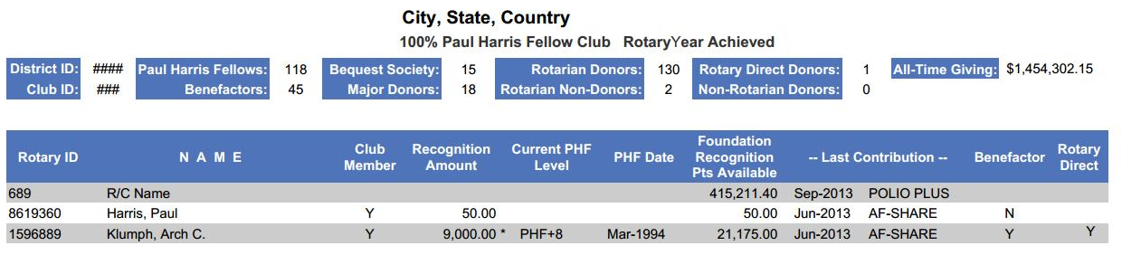
Club Recognition Summary
Recognition amount
  Combination of cash contributions and Foundation recognition points received (points do not count towards Major Donor recognition)
  Maximum amount that can be shown on the report is 9,000 (PHF +8)
Foundation recognition points
  Can be transferred to other individuals to help them achieve PHF recognition
  Points accumulate 1:1 for every dollar contributed to Annual Fund, PolioPlus Fund or global grant
Rotary Direct
  Participating in Rotary’s recurring giving program

Slide 14
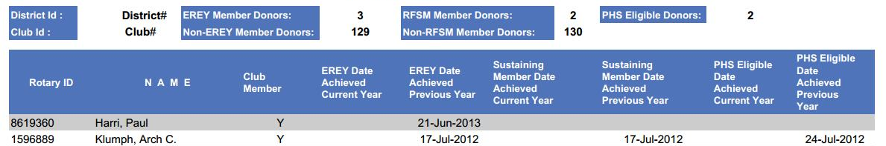
EREY Eligibility Report
Provides recognition eligibility (ie: date achieved for current & prior Rotary year)
Every Rotarian Every Year
  Contribute any amount to the Annual Fund
Sustaining Member
  Contribute at least US $100 to the Annual Fund
Paul Harris Society
  Contribute at least US $1,000 to Annual Fund, PolioPlus Fund or global grant

Slide 15
Secret Codes
94 en - Multiple Donor Form
102 en - Recognition Transfer Request

Slide 16
The Rotary Foundation Multiple Donor Form

Slide 17
Paul Harris Fellow Recognition Transfer Request Form

Slide 18
Contact Center
Answer Rotary Questions
  My Rotary
  Donations, refunds, corrections
  Paul Harris Fellow issues
  Foundation recognition points
  Recognition items
  Enroll in Rotary Direct
  J0in the Paul Harris Society

Slide 19
Contact Center
How to get help
  Email contact.center@rotary.org
  Call 866-976-8279

