Slide 1
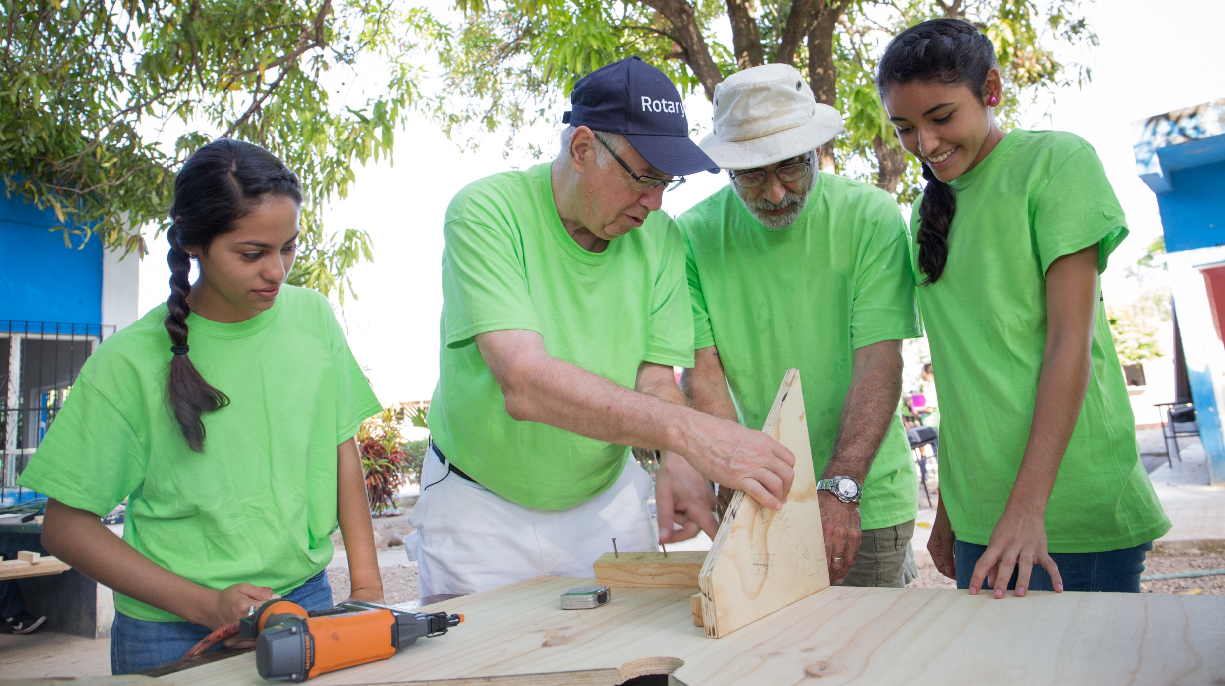
international service
Presented by John Tulac
District International Service
April 11, 2025
Notes:
Instructions: notes to the presenter are in italics.
Tailor this presentation to your region and audience. If you have a region that develops strong projects and grants, task the audience with motivating their clubs/members to build a network of expertise for mentoring fellow clubs with the project planning process.
Encourage collaboration amongst leadership and with expertise. If your region is not active in international projects, smaller ones or global grant-supported, use this presentation to motivate greater engagement. End the presentation with a call to action based on your audience -- and if you are a District International Service Chair, position yourself as a resource.

Slide 2
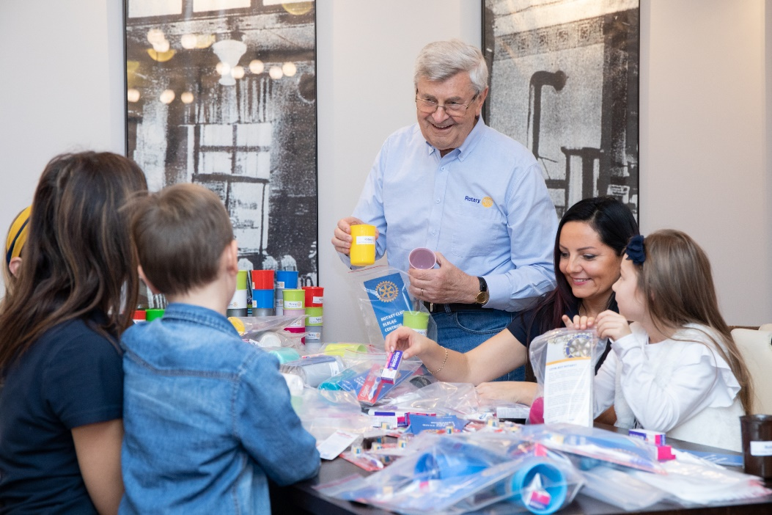
International Service
District 5300 International Service Committee
Project Review & Support
Resources
District Endorsed Projects:
Rotoplast
Superbuild
Notes:
[International Service]
Thank you for the opportunity to present on international service, the role of District International Service Committee Chairs (DISCs), and District Resource Networks – the district framework that supports club and district involvement in international service.
International service is an overarching priority for our organization. Clubs and districts can be involved in small and large scale international service activities:
Either as the host or an international partner; and
Either funded through your own fundraising efforts and partnerships
Or through the Foundation if it meets eligibility for a district or global grant.

Slide 3
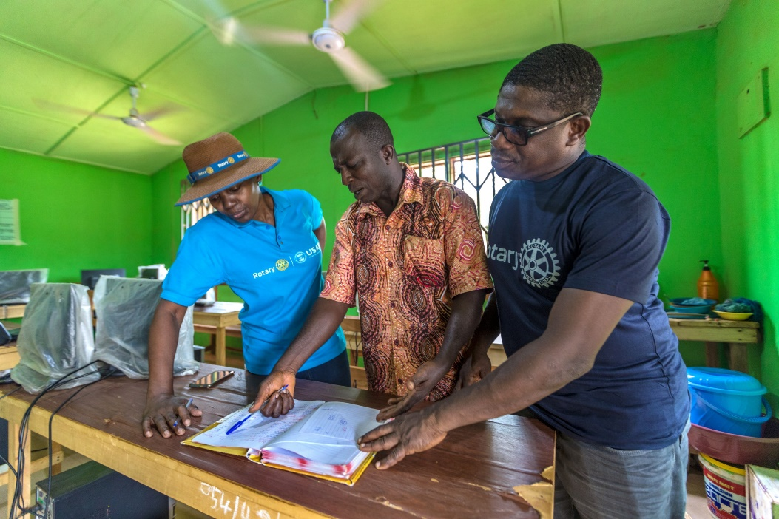
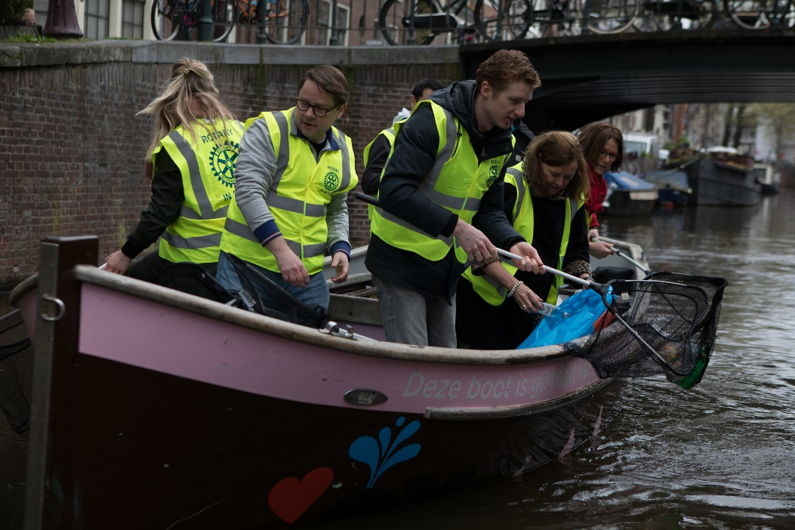
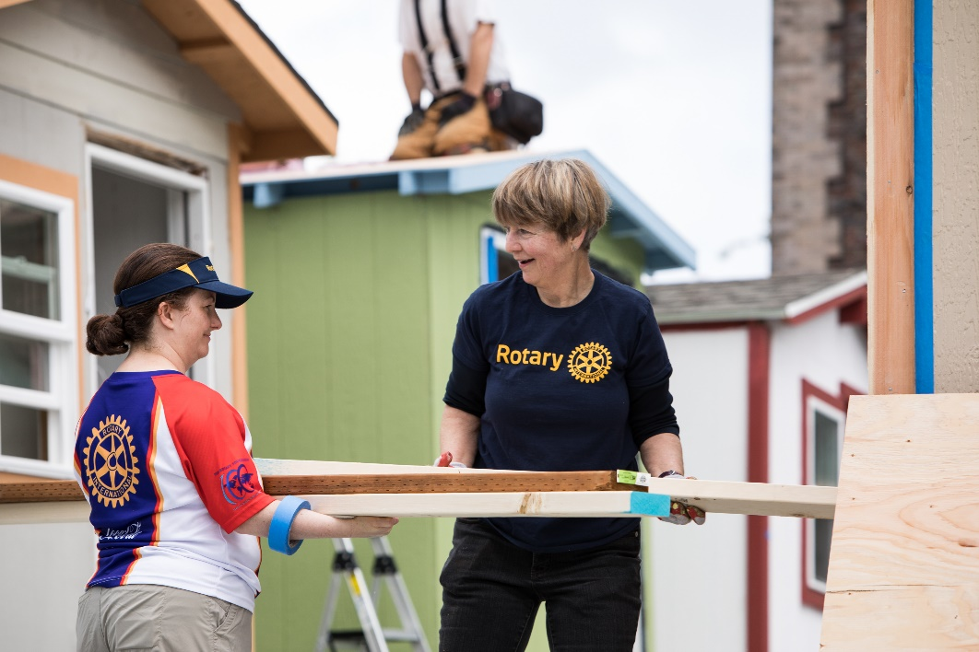
International Service Committee
MOTIVATE
INCREASED ENGAGEMENT
PROMOTE USE OF MENTORS AND RESOURCES FOR PROJECT & GRANT PLANNING
COLLABORATE WITH DISRICT & CLUB LEADERS
CONNECT
THEM TO RESOURCES
IDENTIFY LOCAL MENTORS, RESOURCES
SHARE
BEST PRACTICES
Notes:
[International Service Committee Chairs]
For today’s [Insert type of event: workshop, training, presentation, etc.], we’re going to focus in on international service: club and district involvement in humanitarian service in conjunction with international partners. To motivate and support club involvement in international service, district governors are encouraged to appoint district international service committee chairs.
The district international service committee role has existed for many years – it’s not a new role.
Its duties include:
Motivating club and district involvement in international service;
Finding international partners;
Working with district leaders to identify and recruit local subject matter experts to serve as mentors;
Promoting greater awareness of resources and strategies for stronger international projects and grants by leveraging local Rotarian, Rotaractors, and alumni expertise; and
Establishing direct lines of communication and accountability for all types of international service – and connecting district and clubs to resources.

Slide 4



District International Service Committee Role
MOTIVATES
Clubs to get involved in international service
MAINTAINS
the district resource network, a database of local mentors who can provide guidance and technical expertise
HELPS
Clubs find international partners
SUPPORTS
District Foundation committees and clubs with resources for projects and global grants
COLLABORATES
with district leaders to recruit local experts to join the district resource network
PROMOTES
Rotary publications, online tools, methods and strategies for planning and implementing effective projects and grants
DISTRICT RESOURCE
NETWORK
Available on your district’s website or through your district international
service chair.
Mentors with expertise in project planning, Rotary’s areas of focus, and Rotary grants, including: ROTARIANS ∙ ROTARACTORS ∙ ROTARY PROGRAM ALUMNI ∙ COMMUNITY MEMBERS ∙ PROFESSIONALS FROM PARTNERING ORGANIZATIONS
PUBLICATIONS
Available on My Rotary
COMMUNITY ASSESSMENT TOOLS ∙ GUIDE TO GLOBAL GRANTS
ONLINE TOOLS
Available on My Rotary
ROTARY SHOWCASE ∙ DISCUSSION GROUPS ∙ CLUB SERVICE PROJECTS COMMITTEE BASICS
Notes:
[Updated DISC Role]
I’ll share a brief background on the updated DISC role. In 2016, the Board of Trustee’s approved a new strategy for involving our experienced members in mentoring clubs in projects and grants. The Boards updated the role of DISCs and encouraged three-year term appointments, with the option of reappointment, for continuity.
The DISC role was updated based on lessons learned after a pilot which demonstrated the need to help Rotarians tap into subject matter expertise within their districts or regions; and in order to develop bigger and better projects -- project hosts have to rely on the right technical resources from the very beginning of the planning process.
[DISC Appointments: edit DISC appointment totals and date below with data close to your meeting. For totals, contact Kiki Melonides.]
As of October, 440 districts have reported DISC appointments for 2019-20. In RY 2018-19, there were 384 districts with DISCs. Since the role was enhanced in 2016 and we have been raising awareness, there has been a steady increase in the number of DISC appointments.
[Customize to your audience by adding Zone/District-specific information below:]
In Zone ___, there are ___ districts (out of __ districts) with DISC appointments. Our goal is to have 100 percent of the DISC roles filled.

Slide 5
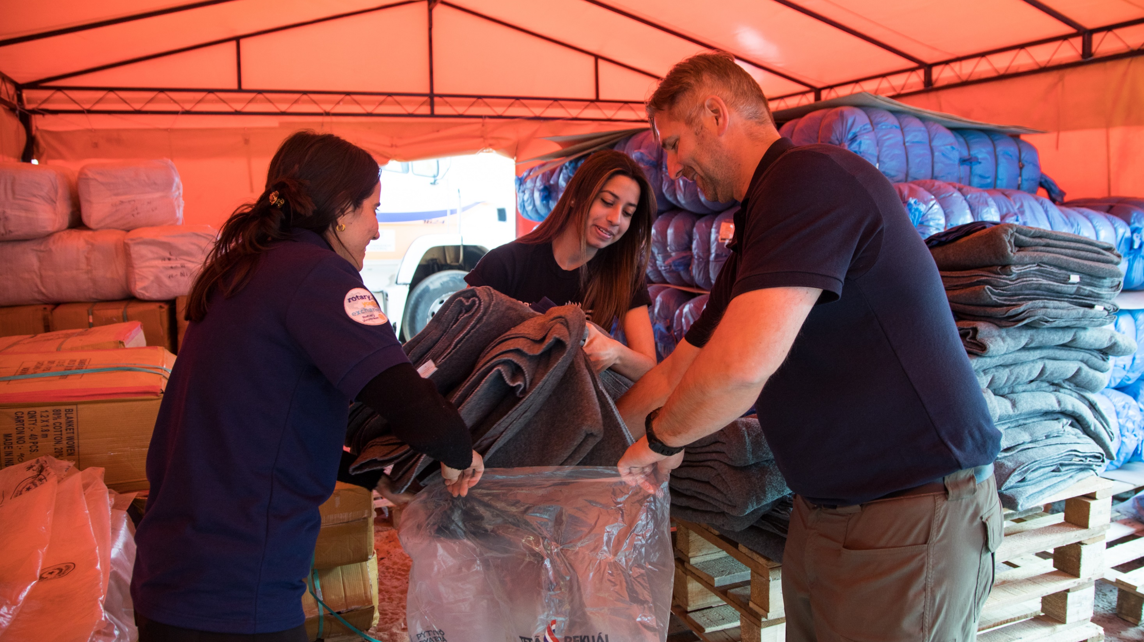
collaboration

Slide 6
DISC Support DRFCs & Other District Leaders
DISC supports fellow District Chairs
District Governor Line
District Rotary Foundation Chair
Club Presidents
Club Foundation Chairs
Club International Projects and Projects Committees
Collaboration among Clubs and between Districts for a single project
Notes:
[DISCs & DRFCs - This slide addresses concerns that the DISC role competes with the DRFC. We want to demonstrate how the DISC’s work supports the work of the DRFC -- also how DISCs work in cooperation and other district leaders.]
Next, we will focus on collaboration among all district roles. DISCs do not compete with district chairs, but instead support them.
DISCs support the efforts of the district Rotary Foundation committee by facilitating collaboration with Rotarian and non-Rotarian experts in District Resource Networks. Although DISCs are not focused on the process of global grants specifically, we do anticipate that leveraging resources to improve overall project design will ultimately lead to more sustainable, higher impact global grants.
District Rotary Foundation Chairs have the responsibility for educating clubs about the Foundation, inspiring them to engage with our programs and to be active with fundraising activities. They serve for three years, which provides continuity in district leadership. They are the main contact for global grants – and are definitely an important ally for DISCs (who should also be appointed to three year terms).
As many of you know, within the Rotary Foundation Committee are subcommittee chairs. DISCs work closely with Grants, Stewardship and Scholarship chairs to stay informed on grant activities. The subcommittee chairs work with DISCs to connect grant proposals with DRN mentors to strengthen grant applications.
Scholarship subcommittee chairs and Alumni chairs can help identify recent scholars, peace fellows, vocational training team members and alumni who are great assets to the District Resource Network. To summarize, it’s all about “Collaboration”– a strong partnership and collaborative relationship with the District Governor, DRFC and other district leaders is key to the DISC’s success.

Slide 7
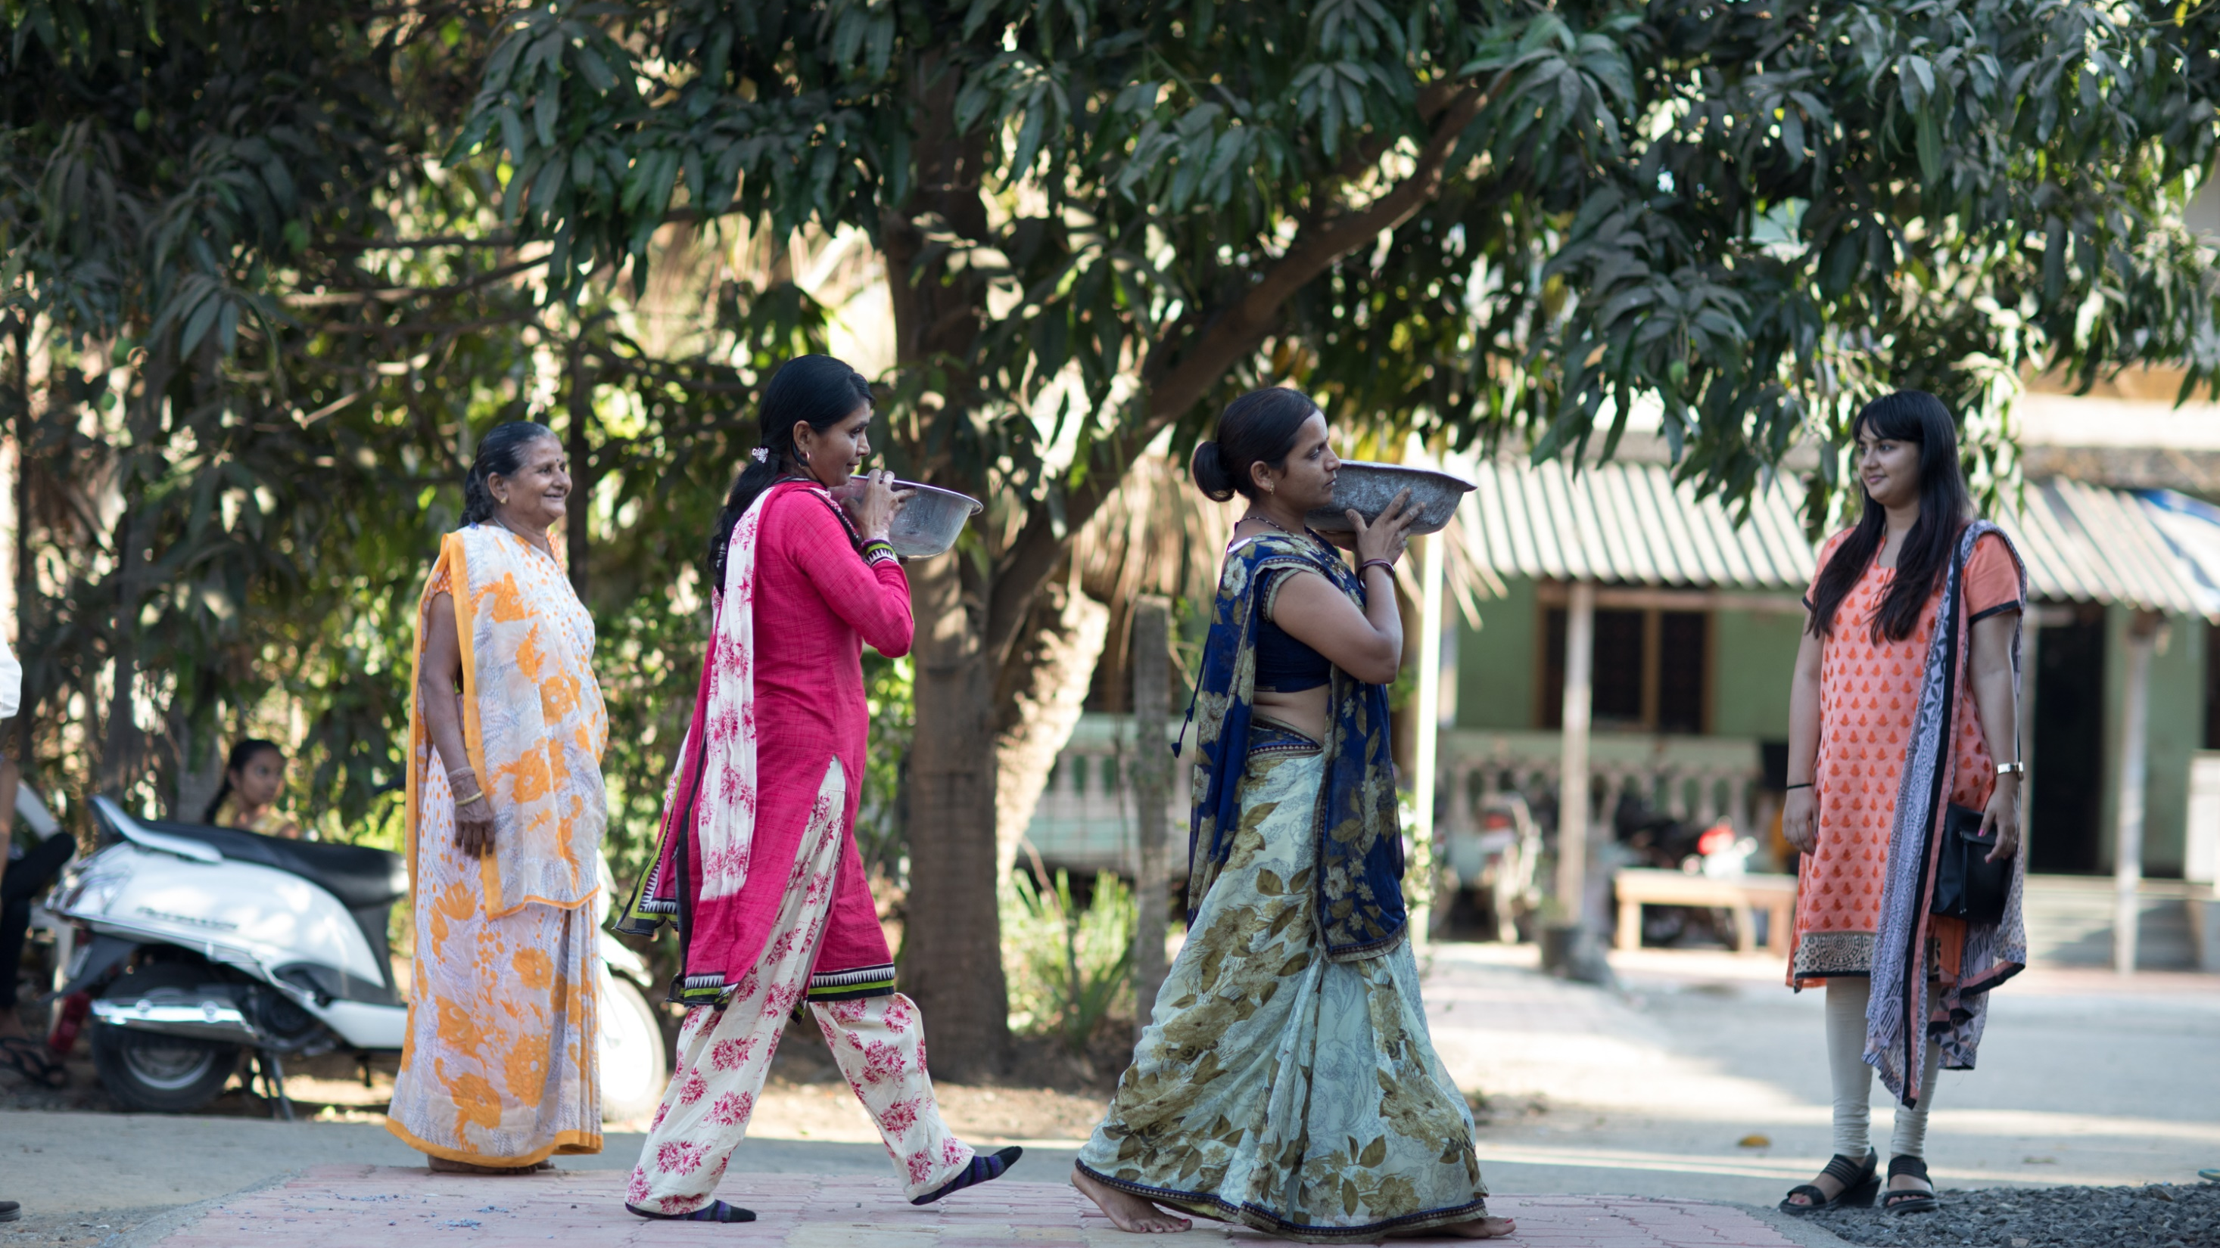
District 5300
Projects
Notes:
[Add your District “Number” to this section slide introducing the next slides with specifics on your District Resource Network]

Slide 8

Provide the MONEY

Slide 9
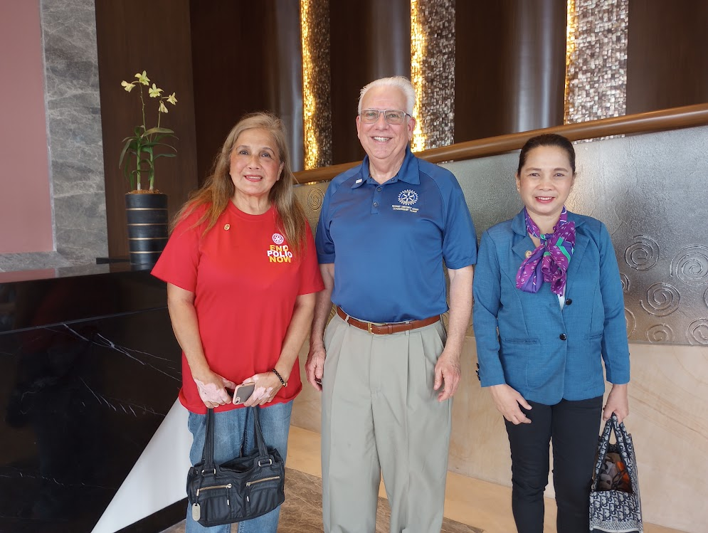
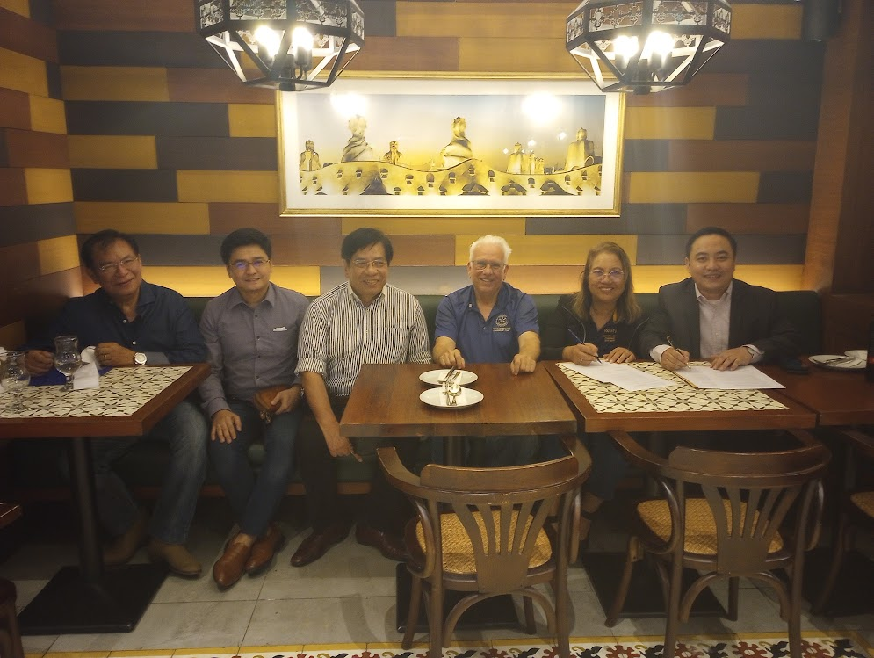
PROVIDE ONSITE WORK & SUPPORT

Slide 10

PARTNER WITH OTHER CLUBS

Slide 11
Recent club Projects San Marino club and The Rotary Club of Claremont
Water project, Tanzania
GG Water supply and facilities improvement for kindergarten in Tijuana, Mexico
Sanitation & hygiene, South Africa
GG Dialysis equipment for health center in Panipat, India
GG Disability enpowerment project in Panipat, India
EKG machine for pediatric center in Zimbabwe
Family aquaponics systems for Sen Sok, Cambodia
Clean air stove project in Guatemala
Uganda Village Peace Mediation
GG Heart surgeries for children in Cairo, Egypt

Slide 12
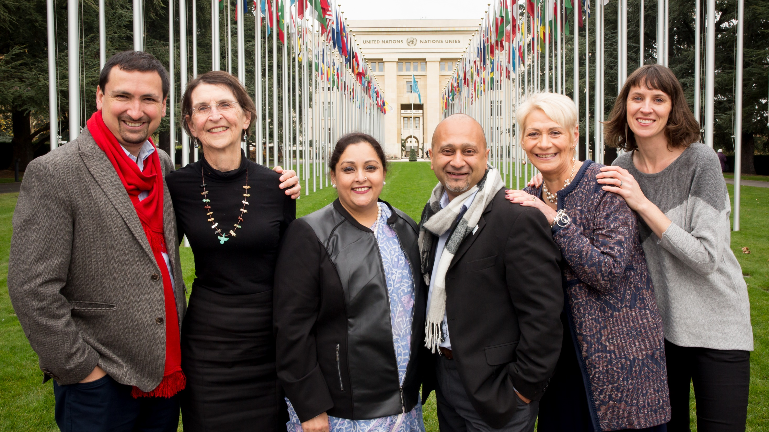
Calls to action

Slide 13
Clubs
Introduce yourself to your DISC
1
Share project or grant ideas with your DISC; ask to be connected with a mentor
2
Encourage club members with experience & technical skills to connect with your DISC
3
Work with your DISC to receive regular updates, resources, best practices, and support for success
4
Notes:
[Use this slide to engage clubs -- Calls to Action for Clubs]
Earlier in the presentation, I mentioned that districts have members with valuable technical skills and experience who could serve as mentors. We need club members, such as yourself, to join District [Number’s] Resource Network - or you can help identify a fellow club member with useful expertise.
You can help by:
Introducing yourself to your DISC (identify your experience or technical skill);
Share you project or grant ideas with your DISC; ask to be connected with a mentor in your District’s Resource Network;
Encourage fellow club members with experience and technical skills to connect with your DISC in order to join your District’s Resource Network:
If you serve as the club international service chair or support projects, work with your DISC to receive regular updates, communications, resources, and best practices for success

Slide 14
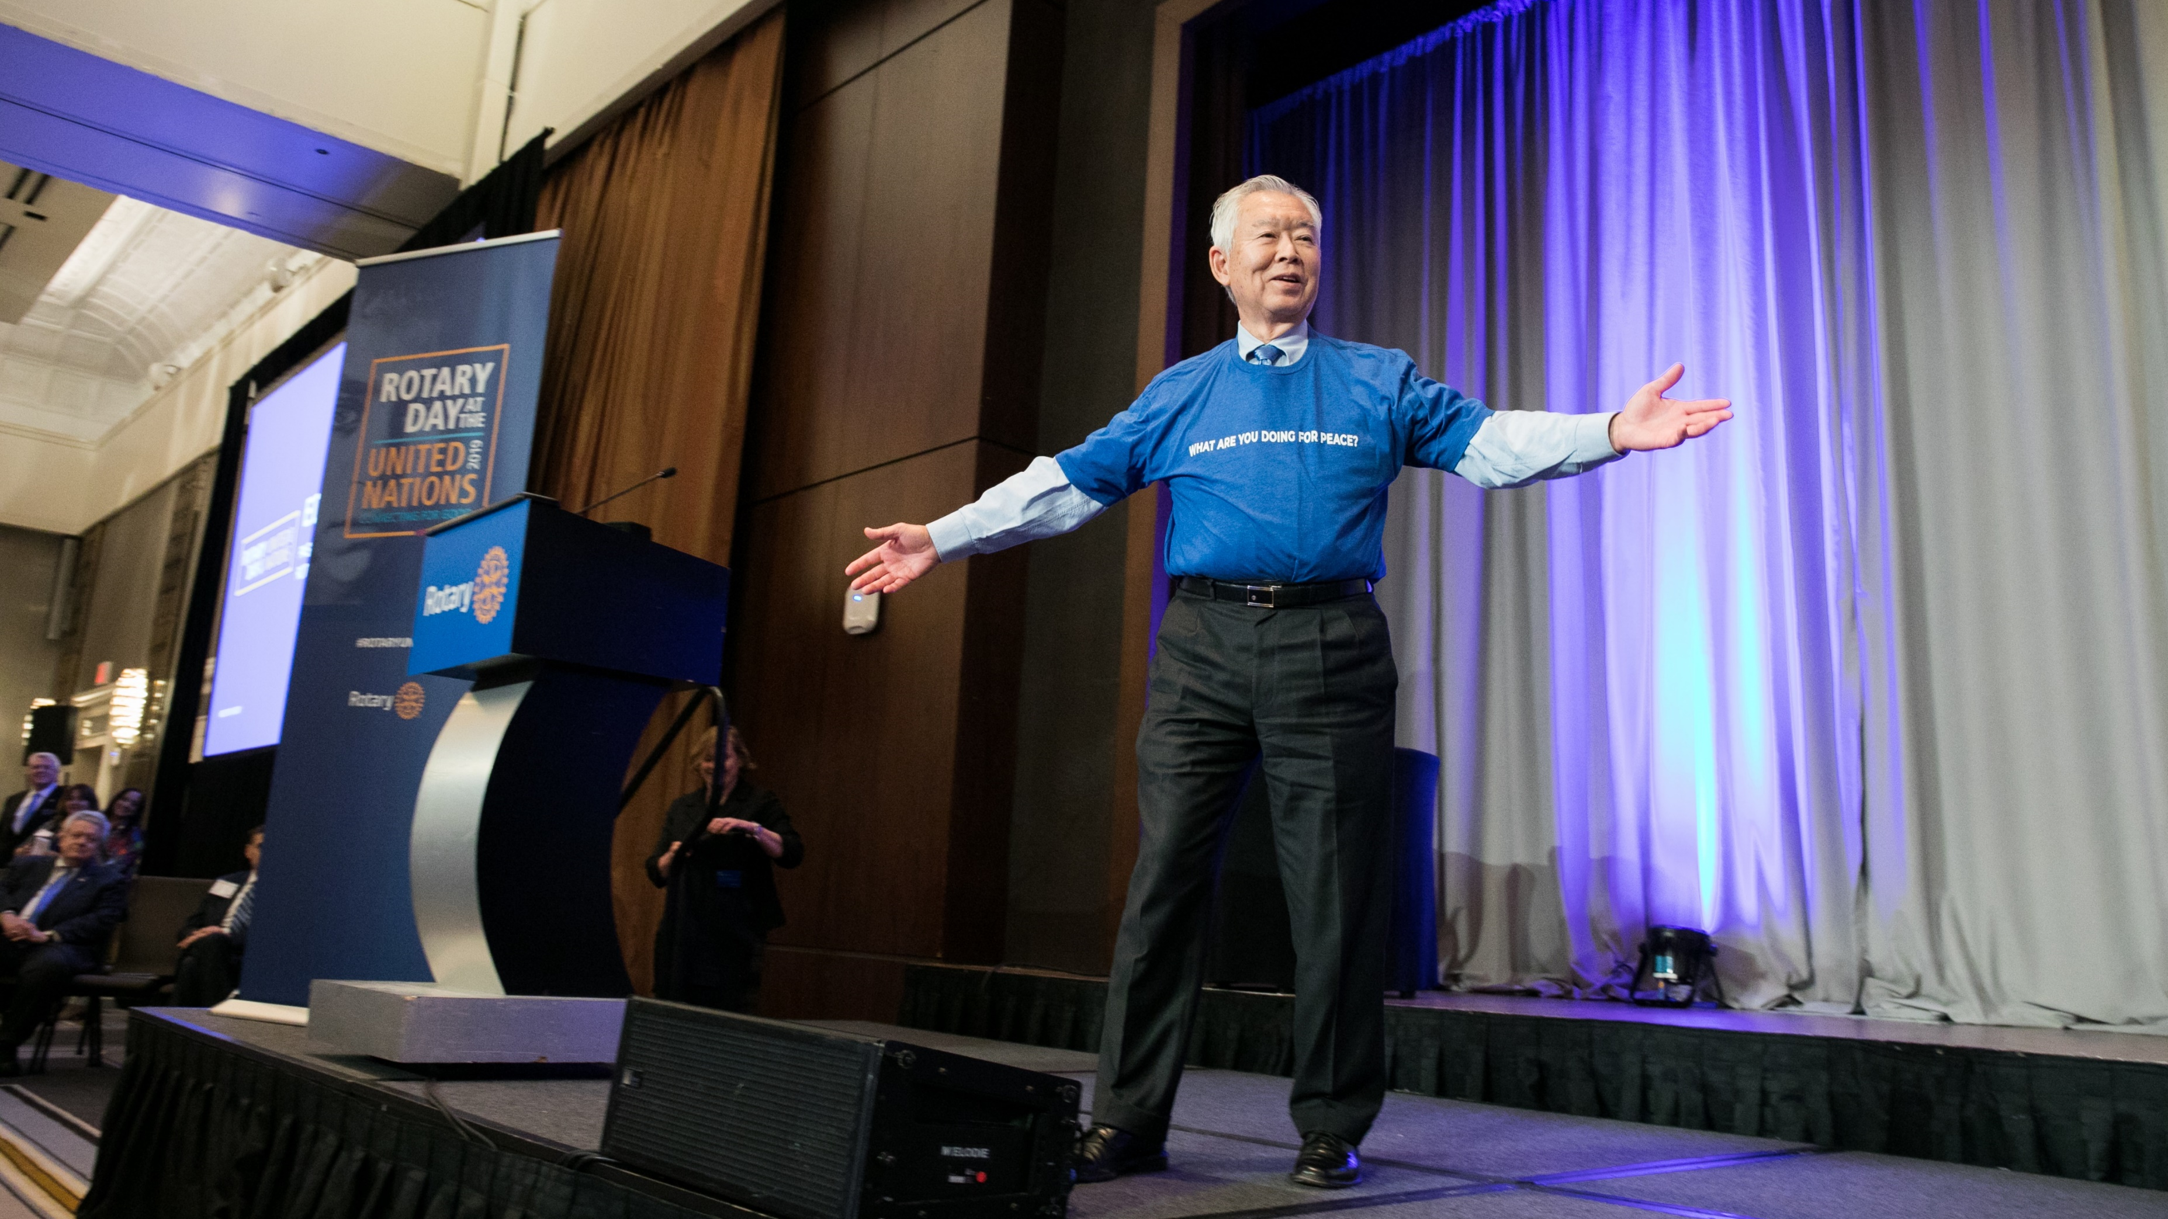
GLOBAL GRANTS
CHEHAB ELAWAR

Slide 15
GLOBAL GRANTS
A Rotary International Global Grant is a funding mechanism provided by The Rotary Foundation to support large-scale international activities (over $30,000) with sustainable and measurable outcomes aligned with Rotary's areas of focus
Purpose: To fund humanitarian projects, scholarships for graduate-level academic studies, and vocational training teams that address pressing needs in communities around the world.
Scope: Global grants support large-scale, long-term impact activities.
Outcomes: They aim for sustainable and measurable results, ensuring long-term solutions to community problems
.

Slide 16
AREAS OF FOCUS
Projects must align with at least one of Rotary's seven areas of focus:
Peacebuilding and Conflict Prevention.
Disease Prevention and Treatment.
Water, Sanitation, and Hygiene.
Maternal and Child Health.
Basic Education and Literacy.
Community Economic Development.
Environment.

Slide 17
ATTRIBUTES
Funding: Global grants have a minimum budget of $30,000 and can be funded using District Designated Funds (DDF), cash, and/or directed gifts and endowment earnings.
World Fund Match: The Rotary Foundation provides an 80 percent World Fund match for all District Designated Fund contributions.
Qualification: Before applying, both the district or club in the country where the activity takes place and the international partner district or club must be qualified.
Sustainability: A key requirement is that projects are designed to be sustainable, enabling the community to continue benefitting after the grant funding ends.
Community Involvement: Projects must respond to real community needs and involve active participation from both Rotarians and community members.

Slide 18
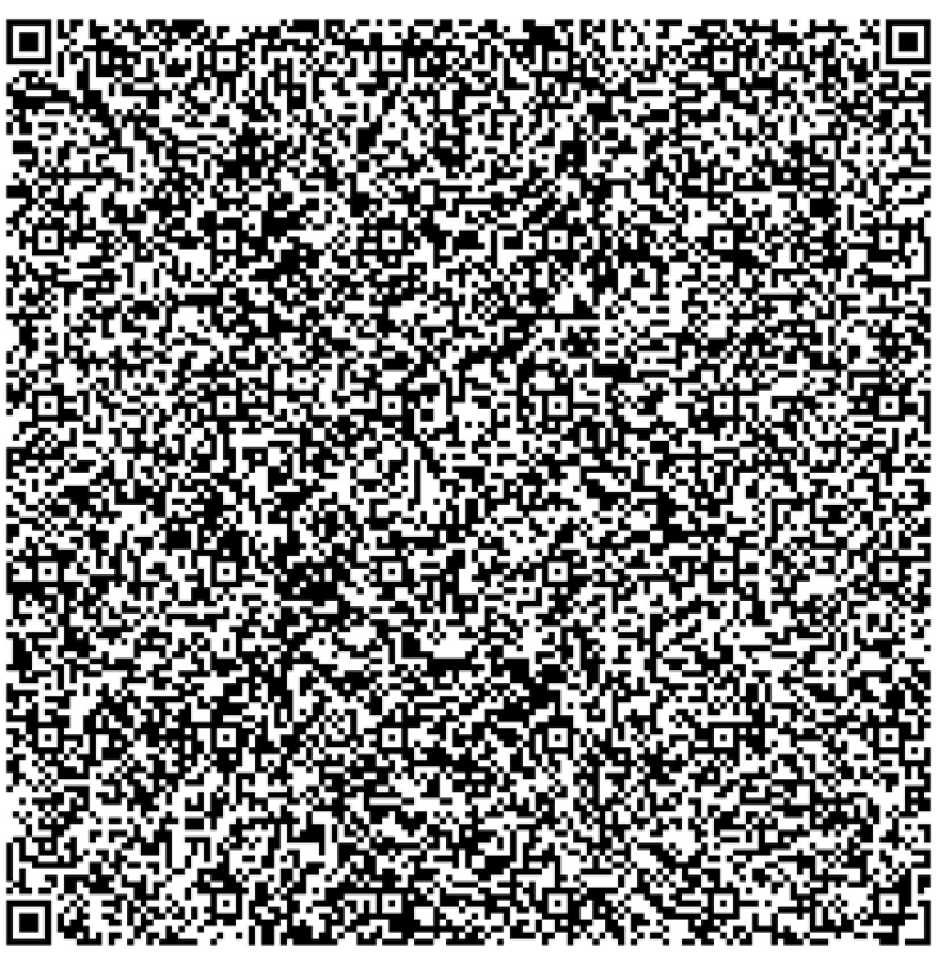
Scan QR CoDe for resources

Slide 19

Thank you
For more information, contact JOHN TULAC DISC Chair
JWTULAC@GMAIL.COM
909-445-1100
Notes:
Kiki Melonides (meh-la-NEE-dez) from Rotary’s Service & Engagement team serves as the main contact for DISCs. She supports efforts to increase their clubs’ participation in international projects, as well as develop District Resource Networks of mentors with expertise to help clubs develop stronger projects and grants. You can contact her at rotary.service@rotary.org.
Thank you.

