Slide 1

Student Orientation
Rotary Youth Leadership Award
District 5300, Rotary International
December 5-7, 2025
Camp Cedar Crest
Running Springs, CA

Slide 2
AGENDA
Welcome Students & Parents
Introductions of Rotarians
Goals of RYLA
What to Expect
What to Bring to RYLA
What Not to Bring to RYLA
Q&A

Slide 3
Welcome to RYLA
  Rotary Youth Leadership Awards (RYLA) is an intensive training program for community youth leaders. Local high school Juniors & Sophomores, chosen for their leadership potential through a competitive interview process, attend an all-expense-paid three day camp.
  The Rotary Youth Leadership Award program was first held in District 5300, Rotary International in 1987.
  Roughly 300 young leaders 150 Female, 150 Male) will attend this year from Southern Nevada and Southern California.

Slide 4
GOALS OF RYLA
Reinforce and provide recognition for your efforts, accomplishments, skills and your potential as leaders
Develop understanding of Rotary among youth participants
Develop leadership skills with an emphasis on:
  Fundamentals of leadership
  Ethics of positive leadership
  Importance of communication skills in effective leadership
  Leadership in problem solving and brainstorming
  Group dynamics and dealing with peer pressure
  Building self-confidence and self-esteem
Notes:
RYLA will help you:
• Develop leadership skills
• Increase self-confidence
• Gain exposure to
a variety of issues and people
• Improve career skills and knowledge
• Meet community leaders and members

Slide 5
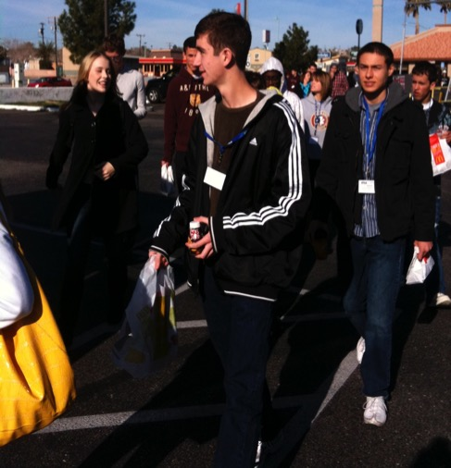
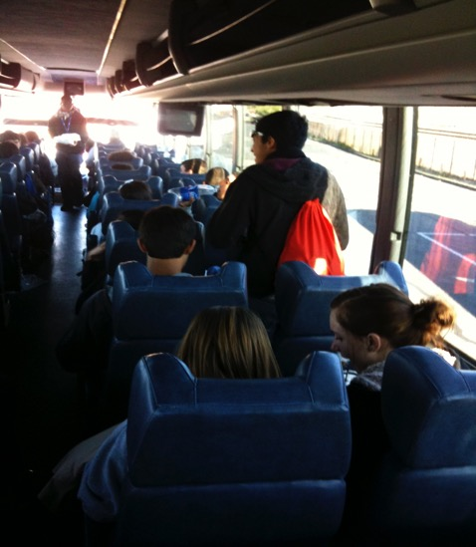
What to Expect
A very early start to your day
The bus will leave on schedule and will not stop. Some busses may have a restroom. Bring water / snacks for the ride
Arrive at RYLA about 11:30 am
Meet your Group, Continent Leader and Facilitator

Slide 6
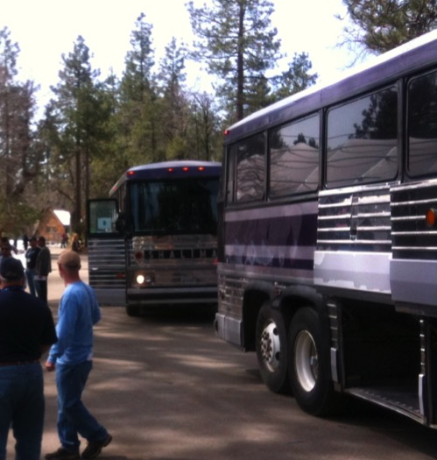
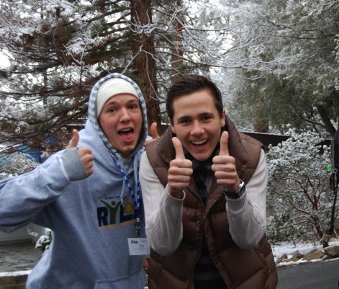
What to Expect
First Day
Expect to have to carry your luggage, as well as your sleeping bag and pillow
Prepare for all kinds of weather – bring large plastic garbage bags labeled for easy Identification
You will sleep in dorms with other students
Wear your name tag at all times except when showering or sleeping
You will not be grouped with your home town friends

Slide 7
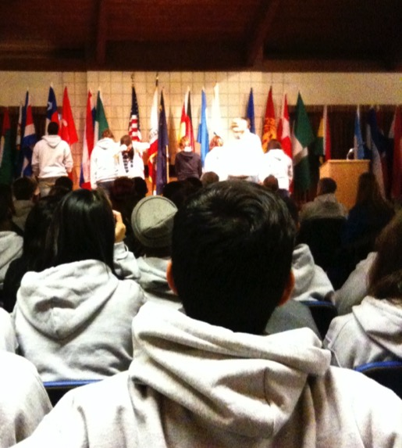
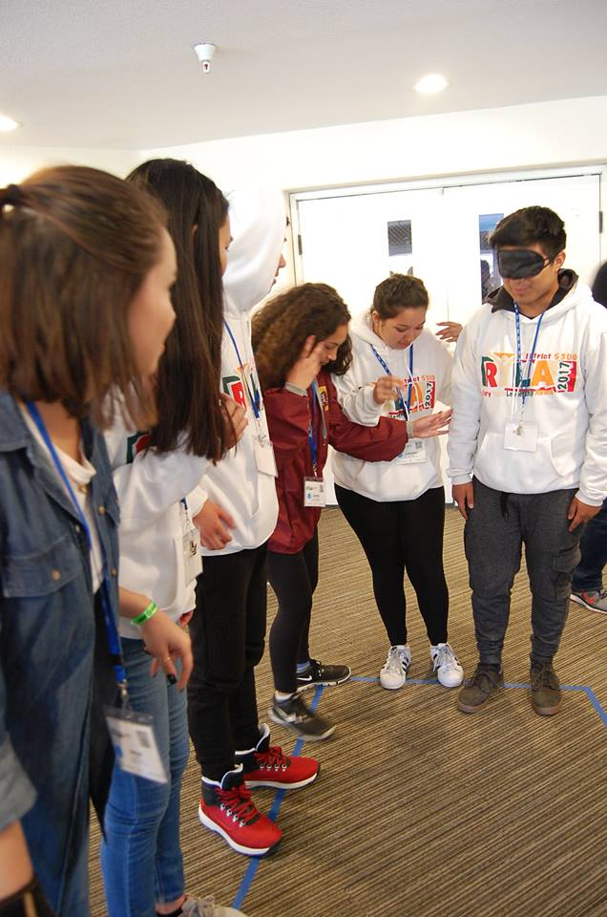
What to Expect
General Sessions & Leadership Labs
General session meetings with great speakers
Each Continent will host a General session
Smaller group labs that will challenge you, reward you, frustrate you and teach you more about yourselves

Slide 8
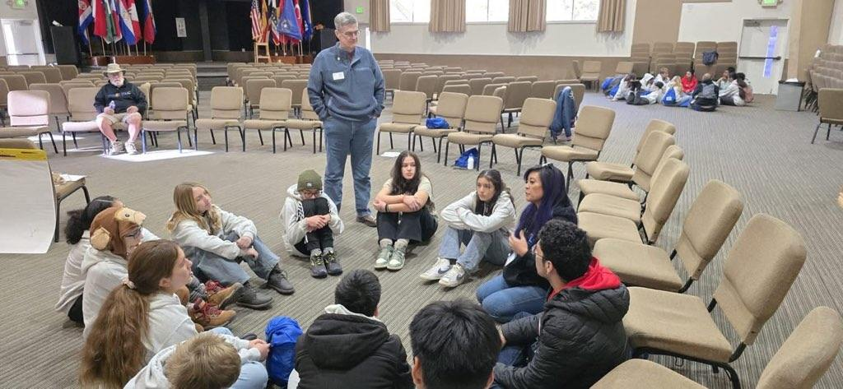
Meals & Social Activities
Opportunities to meet new people and make new friends
Meal times will provide an opportunity to mix with students from other cities and meet other facilitators
Great food served family style
Saturday evening choices of Fellowship Activities

Slide 9


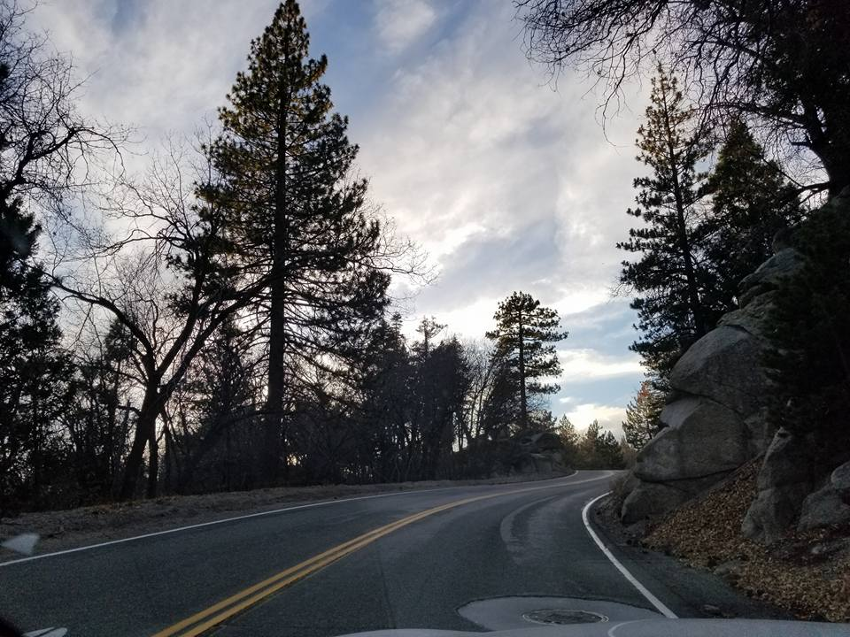
What you need to know
RYLA Guidelines of Conduct will be reviewed at camp, on your first day
Curfews and Dorm Security
Emergency Nurse or Dr
on hand
Find it clean & leave it clean
No cell phone usage, texting or email. Pictures, flashlight and alarm clock usage okay.
We will not hesitate to call your parents to come pick you up, if you break the rules

Slide 10
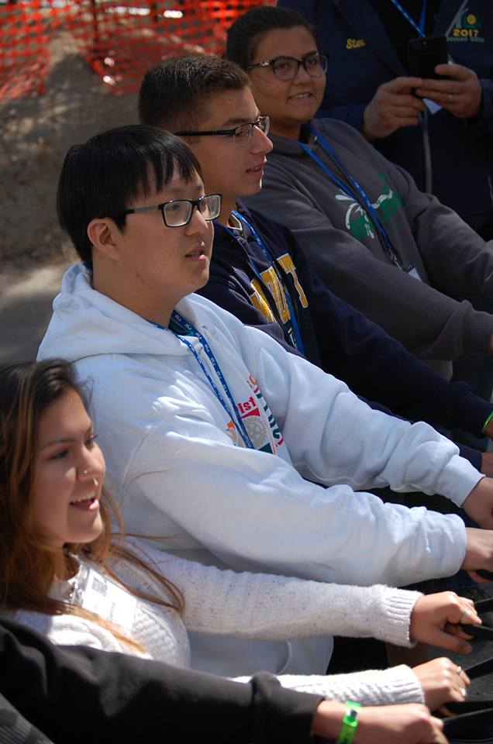
RYLA CHALLENGE
Objective
RYLA participants will be presented with a special challenge for the weekend
Each Participant has the opportunity to create his or her own response to the challenge
Each continent will select one participant who will be featured at the last General Session on Sunday and have an opportunity to share their RYLA Challenge project.
Creativity counts!

Slide 11
WHAT TO BRING
Sleeping bag, pillow, toiletries, bath towel
A warm jacket, hat, gloves and rain gear
Your cell phone to be used for an alarm clock, flashlight, and to check in with family during downtime (you may bring an additional flashlight, lip balm, sunglasses, pen or pencil)
Jeans or sweats, water resistant boots or shoes, warm sleepwear, long-sleeved shirts for sleepwear or to be worn under RYLA Sweatshirt.
Several pair of socks, flip flops or shower shoes. One RYLA sweatshirt will be given to you at camp. Dress in layers; may be sunny or snowing.
Do Not Over Pack – limited luggage space on the busses.
Pack (light) all of your gear in a duffel bag or other suitable luggage that you can carry a far distance.
Also, bring a few large labeled trash bags in which you can place your luggage, sleeping bag, pillow etc... in case of rain or snow. Write your name with a water-proof marker or other markings.
Meds should be in original container placed in a Ziplock bag with name on it. Meds to be turned over to Facilitator prior to boarding the bus.
OPTIONAL: 1 or more non-perishable food item(s) that will be donated to a food bank.
A sense of humor and a great attitude!!

Slide 12
WHAT NOT TO BRING
Weapons of any kind
Alcohol or illegal drugs
Valuables of any kind
Cigarettes, electronic cigarettes, matches or lighters
Laptops, tablet computers, etc.
Formal attire
You do not need money
Swim clothes
School work – there is no time to complete it!
Cell Phones- no incoming or outgoing calls during the day, no social Media or texting (we will take your phone for the weekend) phone may be used to take photos or to complete the RYLA Challenge.

Slide 13
YOUTH PROTECTION
District 5300 is committed to creating and maintaining the safest possible environment for all participants.
Procedures have been created to safeguard both our youth and adult members.
All Rotarians at RYLA have gone through Youth Protection Training and a Background Check. (details on website)

Slide 14
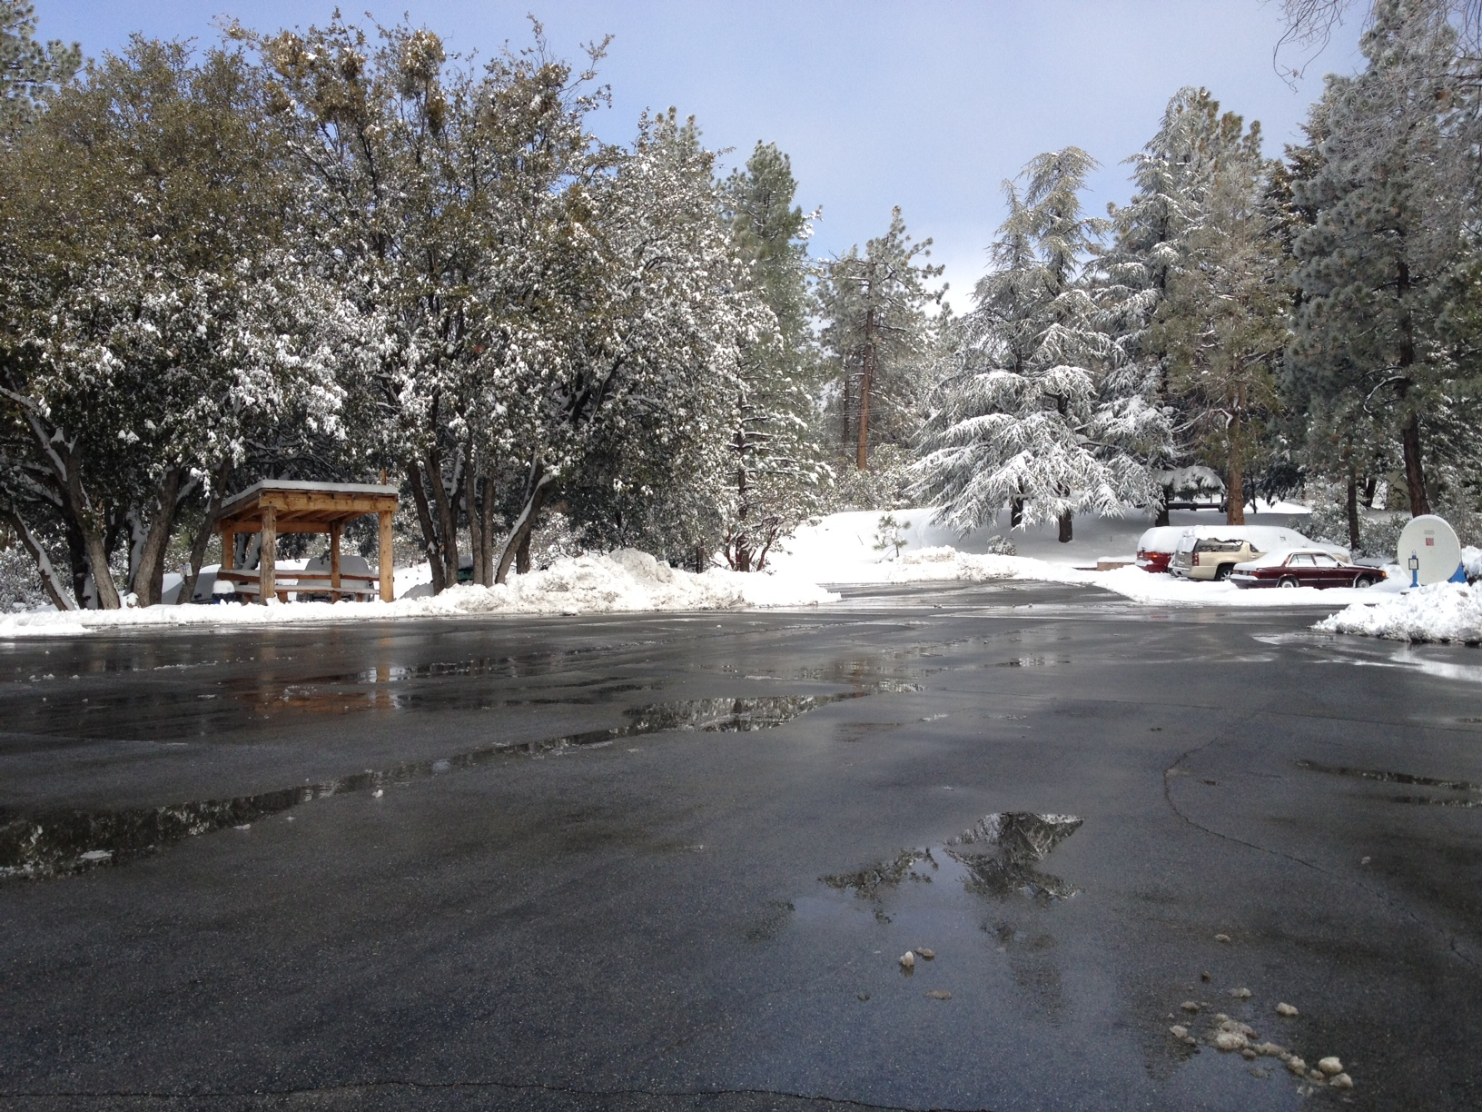
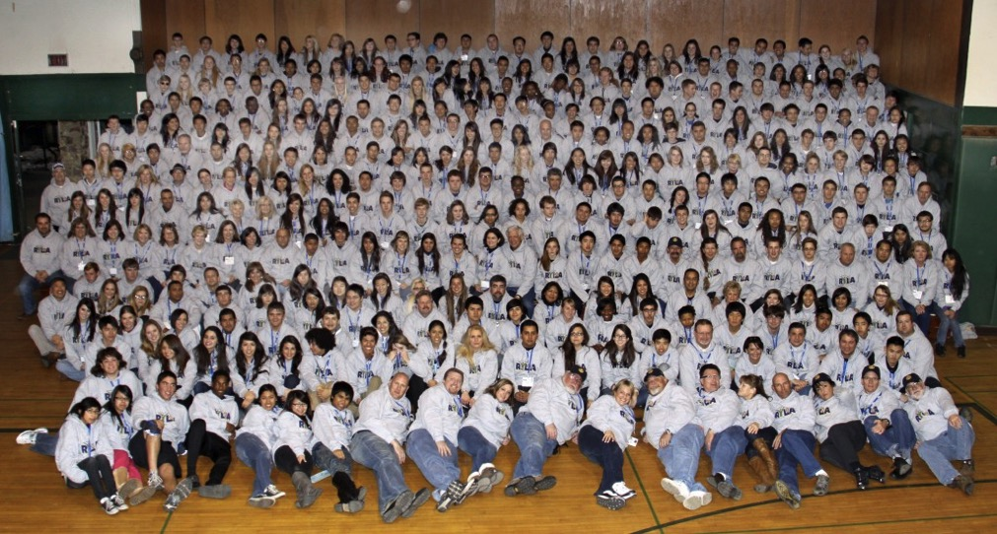
RYLA 2025
Questions?
See you at RYLA
on December 5th!

