Slide 1


The Rotary Foundation
ROTARY ESSENTIALS DECEMBER 13, 2025

Slide 2
ROTARY’S VISION AND ESSENCE STATEMENT
TOGETHER, we see a world where PEOPLE unite and take action to CREATE lasting CHANGE — across the globe, in our communities, and in ourselves.

Slide 3
AGENDA
Our Presenter Team
Why supporting the Rotary Foundation matters
Rotary’s global fight to end Polio
Annual Fund Share
Major Donors and Benefactors
The Paul Harris Fellow program
Global Grant Scholarships
Rotary Vocational Training Team
International Service initiatives
The Seven areas of Focus
Ways to Give to the Foundation
District Grant Process
Global Grant Process

Slide 4


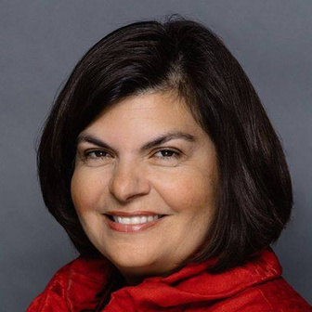
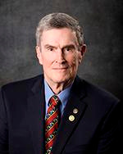
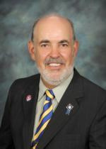
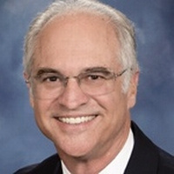
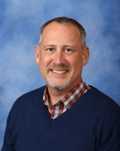
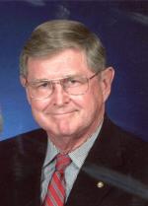
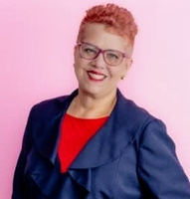
MEET OUR PRESENTERS
District Governor
DRFCC
Global Grants
International Service
Gilda Moshir
Michael Soden
Chehab El Awar
John Tulac
Paul Harris Fellow
Global Grant
Polio Plus Event So NV
Josh Konrad
Bill Payne
Janice Lemcke

Slide 5
Why supporting the RI Foundation matters

Slide 6
Why supporting the RI Foundation matters
It effectively funds sustainable, local solutions to global problems like disease, poverty, and illiteracy, leveraging Rotarians' expertise and a strong financial reputation (high Charity Navigator ratings) to make lasting impacts in peace, health, education, environment, and economic development, turning donations into real-world change for vulnerable communities worldwide.
Key Reasons Why it Matters:
Proven Effectiveness: The Foundation consistently receives top ratings (4 stars from Charity Navigator)
Global Reach,
Focus on Sustainable Solutions:
Addresses Core Global Issues:
Empowers Communities:
Transparency & Trust:

Slide 7
District 5300 Committee Chairs
District Rotary Foundtion Committee Chair (DRFCC): Michael Soden
TRF Annual Fund Subcommittee Chair: Mark Mariscal
TRF DDF Review Subcommittee Co-Chairs: Marcelle Sellers and Kathy Selders
TRF District DDF Grants Co-Chairs: Christine Smith and Michel Soden
TRF District Endowment/Major Gifts Chair:Susan Johnson
TRF District Paul Harris Fellow Chair: Josh Konrad
TRF Global Grants Chair: Chehab El Awar
TRF Global Scholar Chair: Bill Payne
TRF Global Grant Stewards Subcommittee Chair: Josh Konrad and Paul Reyes
TRF Polio Plus Chair: Dean Billman
TRF Storyteller Chair: Robin Smith
TRF Vocational Training TEAM (VTT) Subcommittee Chair: Marilyn Diaz

Slide 8
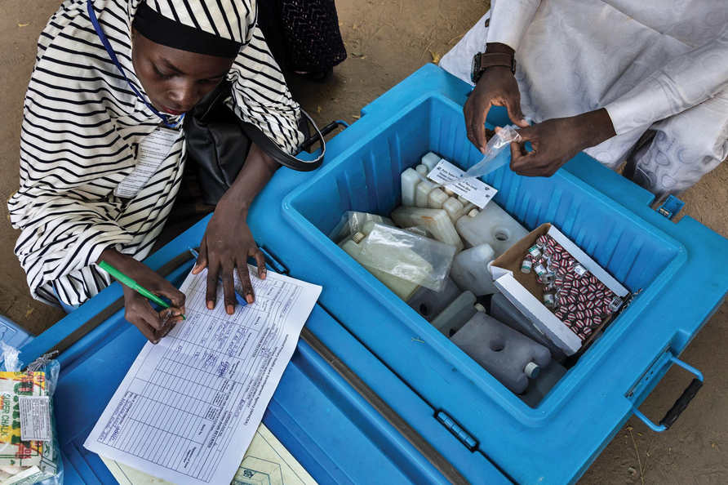
ROTARY’S GLOBAL FIGHT TO END POLIO
Rotary International leads a global fight to end polio as a founding partner of the Global Polio Eradication Initiative (GPEI), partnering with WHO, UNICEF, and the Gates Foundation to immunize children, raise funds, and advocate for a polio-free world.
Statistics
Contributed over $2.9 billion to immunize over 3 billion children.
Reduced polio cases by 99.9%.
Now only endemic in 2 countries (Afghanistan, Pakistan).
For More information
Reported Cases as of 12/11/2025
39
Polio Plus Society

Slide 9


ROTARY’S GLOBAL FIGHT TO END POLIO
Key Impacts and Contributions
Vaccination Outreach: Since 1985, Rotary has provided the oral polio vaccine to more than 3.5 billion children across 122 countries.
Paralysis Prevention: An estimated 19 to 20 million people are healthy and walking today who would have otherwise been paralyzed by the disease.
The "Plus" in PolioPlus: Beyond vaccinations, the program provides added benefits to communities, such as clean water (e.g., solar-powered boreholes in Nigeria and filtration plants in Pakistan), medical treatments, bed nets, soap, and Vitamin A drops that have prevented an estimated 1.25 million deaths.
Infrastructure Legacy: The polio eradication infrastructure is now used to fight other diseases and improve overall healthcare systems worldwide.
Polio Plus Society

Slide 10
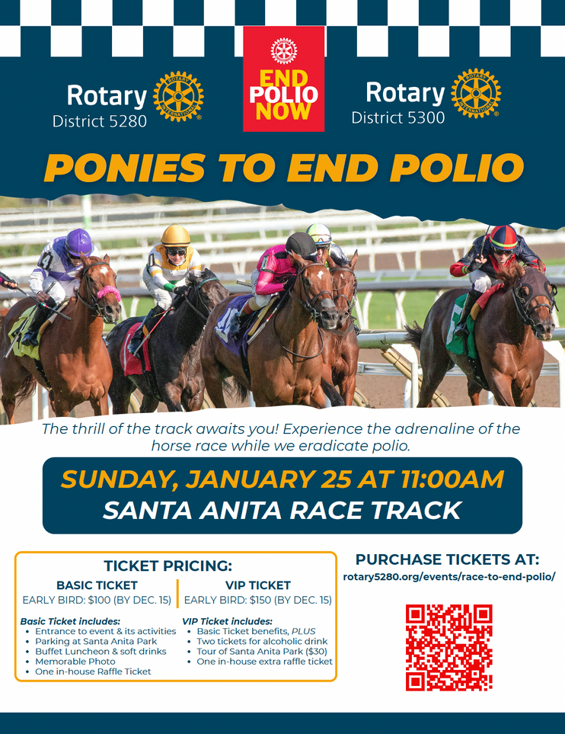
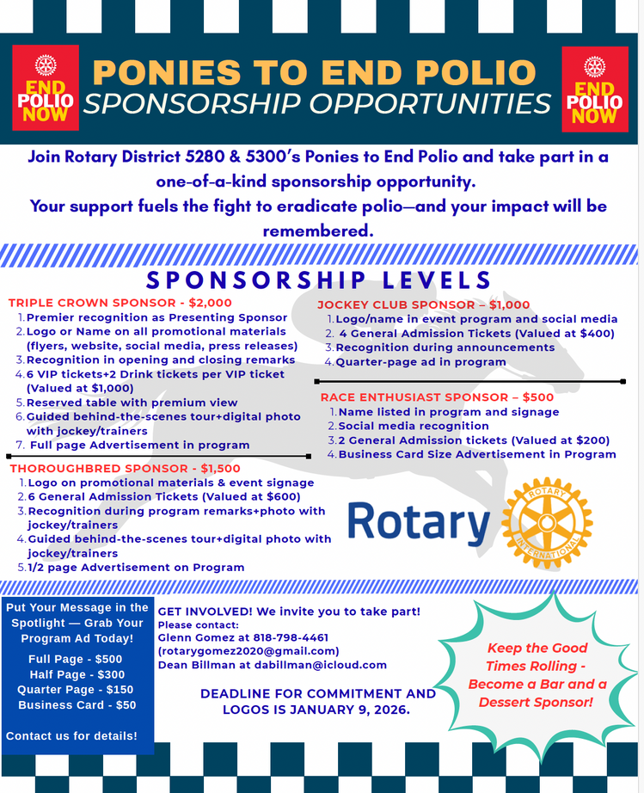
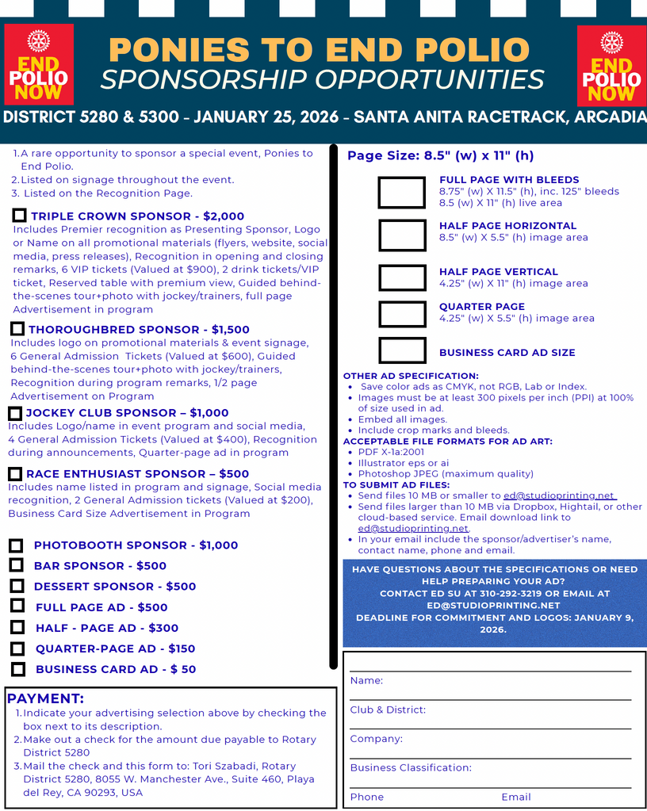
POLIO PLUS FUNDRAISERS (SO CALIFORNIA)

Slide 11
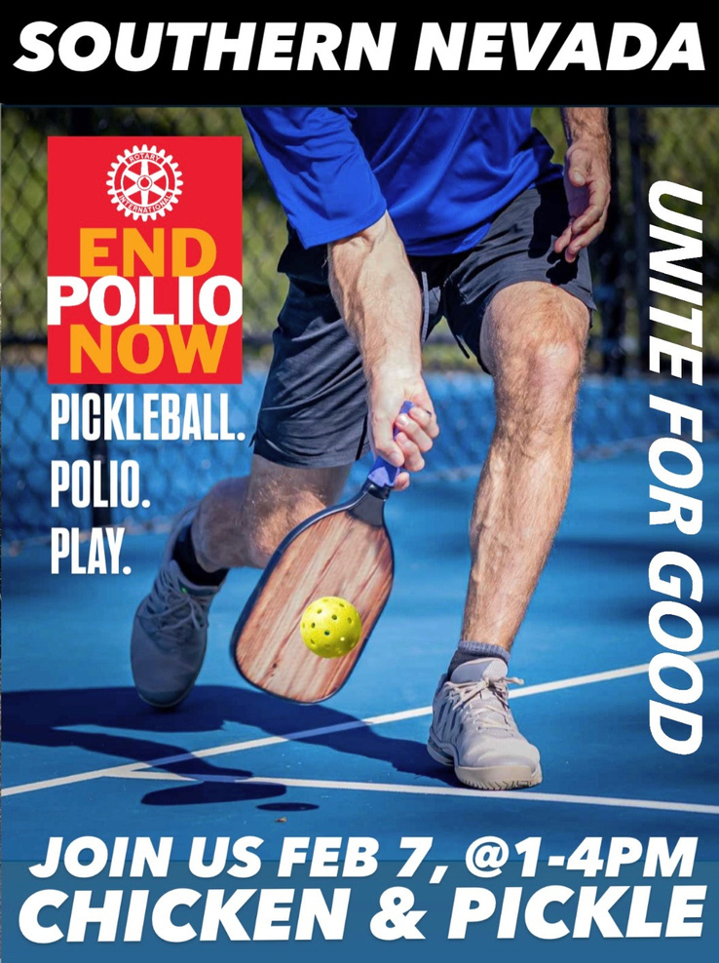
POLIO PLUS FUNDRAISERS (SOUTHERN NEVADA)

Slide 12
ANNUAL SHARE FUND
Rotary Annual Fund-SHARE is the main funding system for The Rotary Foundation, turning member donations into grants for global humanitarian, educational (like scholarships), and service projects, including PolioPlus; contributions are split between a district's District Designated Funds (DDF) (for local use) and the World Fund (for worldwide grants), with a portion covering Foundation costs, ensuring local control over some funds while pooling others globally.
What it Funds
Humanitarian Projects: Local and international efforts to improve lives.
Scholarships & Training: Funding for students and professionals.
Global Grants: Large-scale projects with matching funds from the World Fund.
PolioPlus: Eradicating polio worldwide.
Rotary Peace Centers: Training leaders for peacebuilding.
Key Concepts
DDF (District Designated Funds): Money your district controls for its own projects.
World Fund: Money controlled by Rotary International for global priorities.
EREY (Every Rotarian, Every Year): The goal for every member to give at least $25 annually to the Annual Fund.
How it Works
Contributions: Rotarians donate to the Annual Fund, often encouraged through the "Every Rotarian, Every Year" (EREY) initiative, aiming for $100 per member annually.
Distribution: After 5% covers operating costs, the remaining 95% is split:
47.5% to District Designated Funds (DDF): This money is returned to the contributing district after a three-year investment period for local project funding.
47.5% to the World Fund: This pooled money funds Rotary's highest priorities globally, like PolioPlus and Peace Centers.
Funding Cycle: Donations made in one Rotary year become available as DDF three years later, allowing for project planning and investment.

Slide 13
MAJOR DONOR AND ENDOWMENTS
Rotary Major Donors are individuals giving $10,000+ cumulatively, recognized with special pins and crystals, while endowments are permanent funds where gifts are invested, using only the earnings for long-term Rotary projects, ensuring gifts keep giving in perpetuity, with recognition like naming funds for gifts of $25k+ and prestigious Arch Klumph Society induction for $250k+. Both major giving and endowment contributions support The Rotary Foundation's mission, but endowments focus on lasting legacy through principal preservation, complementing direct gifts to annual funds or PolioPlus.
Rotary Foundation Endowment Fund
Purpose: A permanent fund holding gifts, with only the investment income used for long-term support, ensuring perpetual funding.
Giving Methods: Include bequests, life insurance, securities, or outright gifts.
Named Funds: Gifts of $25,000 or more can establish named endowed funds.
Legacy Society: For commitments of $1 million or more to the endowment, offering exclusive benefits.
How They Work Together
A Major Gift of $10,000+ can be designated to the Endowment Fund, an Annual Fund, or PolioPlus.
Giving to the Endowment creates a lasting legacy, as the principal remains intact, generating income for future generations.
Both paths support Rotary's global service, with Major Donor recognition for cumulative giving and Endowment gifts for perpetual impact.
Rotary Major Donor Recognition
Definition: Individuals or couples whose total outright giving to The Rotary Foundation reaches $10,000 or more.
Levels: Recognized at $10k (Level 1), $25k (Level 2), $50k (Level 3), $100k (Level 4), with increasing crystal and pin recognition.
Arch Klumph Society: Donors reaching $250,000 are inducted into this premier society, with special events and gallery inclusion.

Slide 14
PAUL HARRIS FELLOW
A Paul Harris Fellow is a person who has been recognized as having done something significant for others. The Foundation recognizes them for the contribution of
$1000, which will be spent on Humanitarian efforts around the world. A club recognizes them for service to the club and or the community.
Levels of Recognition
Paul Harris Fellow: 1,000 -$9,0000
Major Donor: $10,000: $1,000,00
Arch C. Klumph Society
Donors who contribute US$250,000 or more may have their portraits displayed in the Arch C. Klumph Gallery at Rotary International's World Headquarters in Evanston, Illinois, USA.
Benefactor
A Benefactor is someone who informs The Rotary Foundation in writing that he or she has made a provision in his/her estate plans for The Rotary Foundation or by making an outright gift of US$1,000 or more to the Permanent Fund.
Bequest Society
Couples or individuals who have made commitments in their estate plans totaling US$10,000 or more.
Rotary Club Recognition Opportunities
Every Rotarian Every Year (ERAY(
a minimum $100 per capita and 100% participation with every active member Rotary year.
100% Paul Harris Club:
Paul Harris Society
The Paul Harris Society is a district-administered recognition for those who elect to personally contribute US$1,000 or more each year to the Annual Programs Fund, PolioPlus, PolioPlus Partners or the Humanitarian Grants program. Individual districts handle all associated recognition for this program, and inquiries should be directed accordingly. Paul Harris Society contributions are eligible toward Rotary Foundation Sustaining Member, Paul Harris Fellow, Multiple Paul Harris Fellow, and Major Donor Recognition.

Slide 15
ROTARY VOCATIONAL TRAINING TEAM
A Rotary Vocational Training Team (VTT) is a group of professionals (like doctors, teachers, engineers) who travel internationally to share their expertise, teach local counterparts, and learn new skills, funded by Rotary grants to build capacity in areas like health, education, or economic development, fostering sustainable community improvement through hands-on training and global connection, evolving from the old Group Study Exchange program.
How it works:
Sponsorship: Requires Rotary clubs/districts from at least two countries (host and international partner).
Funding: Supported by Rotary Foundation Global Grants, using cash and District Designated Funds (DDFs).
Team Composition: Includes a Rotarian leader with expertise and international experience, plus other skilled members (Rotarians or non-Rotarians).
Goals & Impact:
Capacity Building: Strengthens local communities by improving skills and knowledge.
Rotary Focus Areas: Supports one of Rotary's six areas of focus (e.g., disease prevention, education, water & sanitation).
Sustainable Change: Aims for long-term impact beyond the visit.
What it is:
Expert Teams: Groups of professionals (Rotarians or non-Rotarians) with specific vocational skills.
International Exchange: Teams travel to another country to teach local professionals or learn about their own fields.
Hands-on Learning: Focuses on practical skill-sharing, like new irrigation techniques, medical procedures, or teaching methods.

Slide 16
GLOBAL GRANT SCHOLARSHIPS AND PEACE FELLOW
Maybe a best-kept secret program of our Rotary District is the Global Grant Scholarship opportunity, for applicants seeking a Masters’ or Doctorate degree, abroad. The entrant need only qualify with previously demonstrated alignment to one of RIs seven Areas of Focus.
Since the inception of the GG Scholar program, our District has had 28 who have benefitted from this experience. But participation has only been from a little more than a handful of our Clubs: Altadena, Arcadia, Las Vegas, Pasadena, Palmdale Sunrise, San Marino, Sierra Madre and Victorville.
As this is a minimum of a $30,000 scholarship, it would seem that a worthy candidate may be: a neighbor; member of your church or other civic associations; or worth prospecting at your local high school (they could provide a qualified list of previous alums, now graduating seniors in college). The District interviews will be in March 2026.
Should you need assistance to get started, please check out the District 5300 website, and/or call me. Thanks for your interest; your scholar will be eternally grateful.

Slide 17
GLOBAL GRANT SCHOLARSHIPS PROCESS
District 5300 has committed funding for awarding one Global Grant scholarship for 2025-26. A second scholarship may be available if otherwise committed District Foundation funds are not spent.
The scholarship is to supplement a student’s costs to obtain a Masters’ (or Doctorate) at a foreign university of one’s choice (in a city where there is a Rotary Club). Direct relatives of Rotarians may not apply. A Rotary Club may submit only one scholar applicant per year for consideration.
A scholarship amount is a minimum of $30,000, funded by District 5300 and Rotary International. The sponsoring Rotary Club is encouraged to add another $1,000.
A potential scholar’s coursework in high school and college, extra-curricular activities, and career goals, must align with a RI Area of Focus. These Areas are: Promoting Peace; Fighting Disease; Providing Clean Water; Saving Mothers and Children; Supporting Education; Growing Local Economies; and Objectives for the Environment.
The candidate must have lived (attended all or most of K-12) within the boundary of District 5300, and/or graduated from a college or university within the boundary of District 5300.
Scholarships | Rotary International
An interested student must complete the RI Global Grant Scholarship template ( ). This application is to include: transcripts; a resume; and proof of acceptance (conditional or final) from the foreign university of one’s choice. If the latter is still pending, provide some communication that an application to the foreign university has been submitted and is under consideration. Applications are due to the sponsoring Rotary Club by February 28, 2026.
There will be two interviews: one at the Club level (where the Club Board of Directors must approve the candidate); and a second, by the District Global Grant scholar committee.
Candidates will be scheduled for a face to face (preferred) or an on-line interview, by mid-March 2026. This scholarship is subject to final approval of Rotary International.
McMullin Graduate Scholarship
District 5300 also offers post-graduate scholarships to a foreign university of one’s choosing, but specifically for a graduate of the United States Military Academy or Claremont McKenna College.
The J. Carolyn and Joseph B. McMullin Endowed scholarship was created by Joseph McMullin in 2011 with $150,000. Four scholarships have thus far been awarded with the interest generated. Approximately $7,300 is currently available.
McMullin was a member of the Altadena Rotary Club from the late 60s to June, 2000 where he served as President, and as a District Governor (1988-89). He died September 19, 2019, in North Myrtle Beach, SC, at 96 years of age. He was a World War II veteran, and is interred at Arlington National Cemetery in Arlington, VA.
For more information about these available scholarships, contact:
District Global Grant Scholar Committee:
Chair William Payne, bill.payne10@gmail.com/
District Foundation:Chair:
Michael Soden, dgms2324@gmail.com /

Slide 18
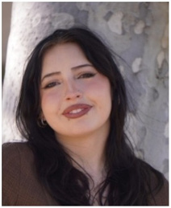
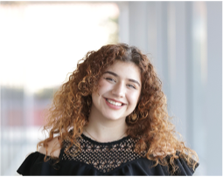
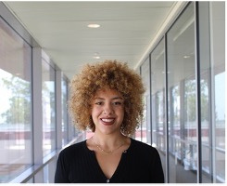
GLOBAL GRANT SCHOLARSHIPS AND PEACE FELLOW
RECRUITMENT OF GLOBAL GRANT APPLICANTS
1. Who do you know, neighbor kids, from church, etc.
2. Article in the local paper, telling what the scholarship is, what it’s worth, and who to contact.
3. Remind RYLA, TLC, 4-Way Test Contest, Stover Music Contest, Business Plan Competition participants who attend your meetings, that this scholarship opportunity exists
4. Ask the Guidance/College & Career Center staff at your local high school for their recommendations, based on:
Grades, beginning at 4.6 GPA
Activities throughout high school: leaders and high achievers
Candidates in Speech and Debate, or school plays/musicals interview well
“A” personality types…there is an Ambassador aspect to the scholarship
5. Ask previous scholars to post their scholarship on their social media sites
6. Propose a newspaper release telling of your latest scholar acceptance, with Rotary contact information
District 5300 Global Grant and Joseph McMullin Scholars 2024-25
Annabella Garcia
GG Scholar
AGuadalupe Mendez
McMullin Scholar
Ilma Turcios
GG Scholar
Annabella Garcia, Peace Building and Conflict Prevention, University of Dundee, Scotland, sponsored by Victorville Rotary, Margaret Cooker
Guadalupe Luza-Mendez, Peace Building and Conflict Prevention, Utrecht University, Netherlands, sponsored by Pasadena Rotary, Fred Findley
Ilma Turcios, Peace Building and Conflict Prevention, London School of Economics, London (UK), sponsored by Pasadena Rotary, Fred Findley.
International Scholar from Japan
Takayuki Noma, sponsored by the Tokushima-Chuo Rotary Club in Japan, is attending and doing research at the Beckman Research Institute of City of Hope, in Duarte. His host is Duarte Rotary, Darrell Brooke.

Slide 19
INTERNATIONAL SERVICE COMMITTEE
Key Functions:
Examples of Projects & Focus Areas:
Project Development:
Identify needs, design, and implement projects (e.g., clean water systems, medical aid) in other countries.
Resource Network:
Build connections with experts (technical advisors, alumni, Rotary Action Groups) to support project planning and grants
.
Grant Facilitation:
Help clubs prepare and manage The Rotary Foundation Global Grant applications.
Awareness & Education:
Promote international service opportunities and educate members on Rotary's Areas of Focus (like Peace, Literacy, Environment).
Partnership Building:
Connect local clubs with international partners for joint initiatives.
Water & Sanitation:
Installing water purification systems in villages.
Health:
Providing wheelchairs, medical supplies, and supporting polio eradication.
Education:
Supporting literacy programs and basic education.
Community Development:
Empowering communities through local leadership via Rotary Community Corps (RCCs).

Slide 20
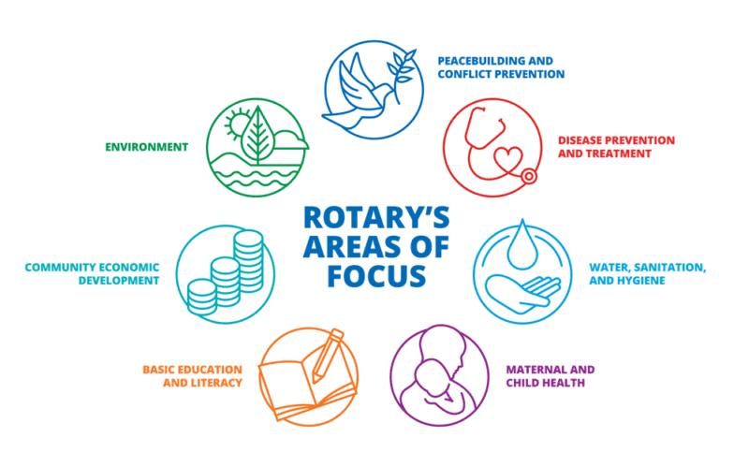
7 AREAS OF FOCUS
Peacebuilding and conflict prevention:
Rotary works to prevent and mediate conflicts by fostering understanding and addressing the root causes of conflict, such as poverty and discrimination
Disease prevention and treatment:
Initiatives focus on combating diseases like polio, HIV/AIDS, and malaria, and improving access to health care
Water, Sanitation & Hygiene: Supports community-led solutions for clean water, sanitation, and hygiene education.
Maternal and child health:
Rotary projects aim to improve access to quality health care so mothers and children can live and grow stronger, and to reduce child mortality rates.
Basic education and literacy:
The focus is on ensuring everyone has the opportunity to achieve literacy and gain basic education.
Community economic development:
This area supports activities that strengthen communities and provide economic opportunities for their members.
Protecting the Environment:
Directly addressing climate change, conservation, biodiversity, and sustainable resource use.

Slide 21
7 AREAS OF FOCUS
How Rotary Does It
Global Grants:
Funding large-scale projects like reforestation, solar power for schools, and clean water systems.
Local Projects:
Club-led initiatives like community cleanups, tree planting, recycling drives, and promoting eco-friendly practices.
Partnerships:
Collaborating with environmental NGOs, governments, and businesses.

Slide 22
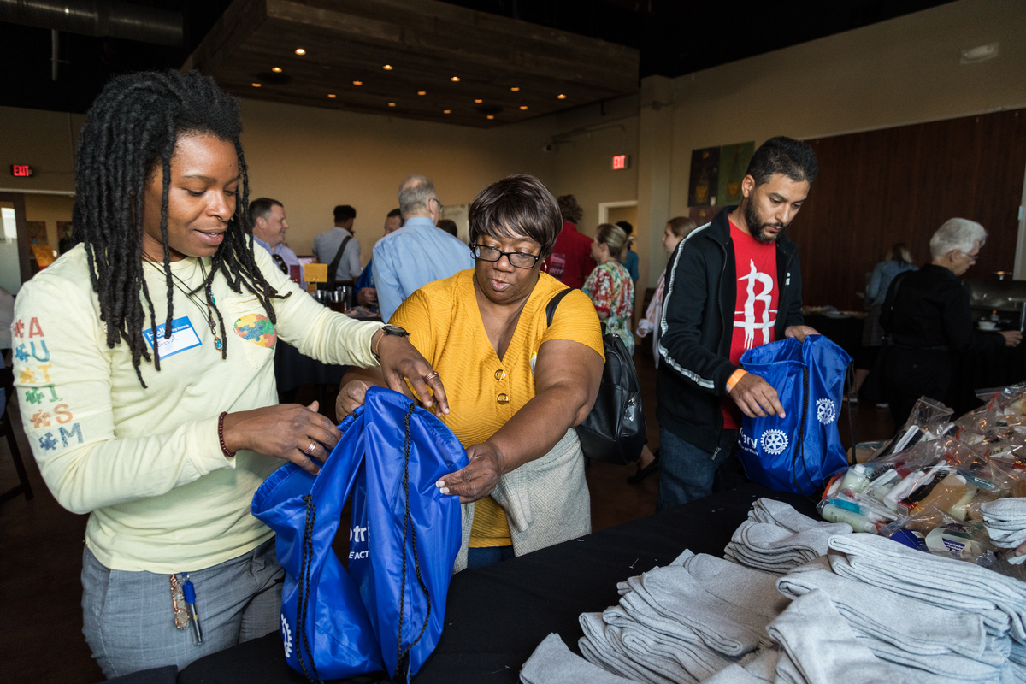
HOW TO GIVE
Quick Ways to Give
Online: Visit Rotary.org/donate for one-time or recurring gifts.
Rotary Direct: Automate monthly, quarterly, or annual donations online.
Local Club: Give cash or check to your club's Foundation Chair.
How to Choose Where Your Money Goes
Areas of Focus: Support specific causes like disease prevention, clean water, or economic development.
Global Grants: Fund large-scale projects in partnership with local clubs.
Unrestricted: Let the Foundation direct funds where most needed.
Specific Giving Programs & Types
Annual Fund: The primary fund for Rotary's programs; become a sustaining member with $100/year.
Endowment: Grow your gift's impact for future generations.
Planned Giving: Include Rotary in your will, trust, or estate plan.
Securities: Donate stocks, mutual funds, or other appreciated securities.
Real Estate: Give land, homes, or farms (with committee approval).
Donor Advised Funds (DAFs): A charitable checking account for flexible giving.

Slide 23
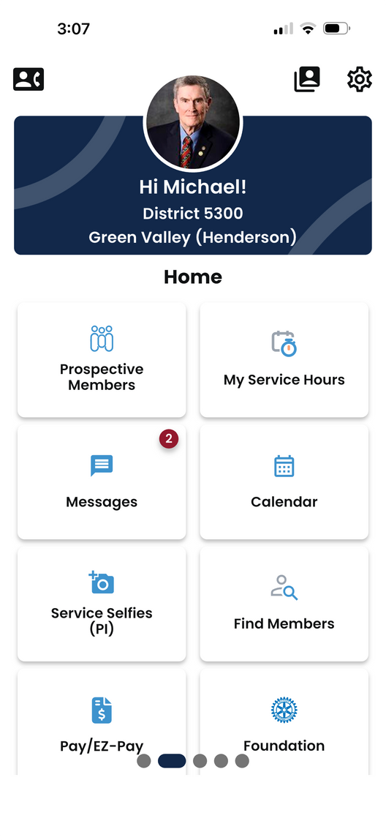
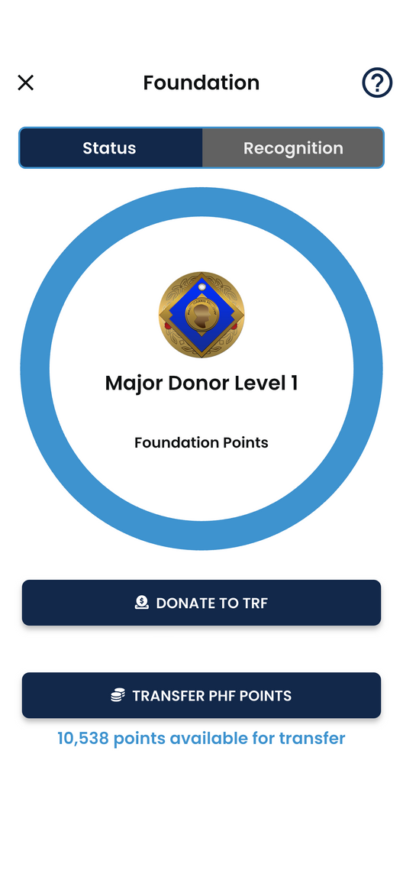
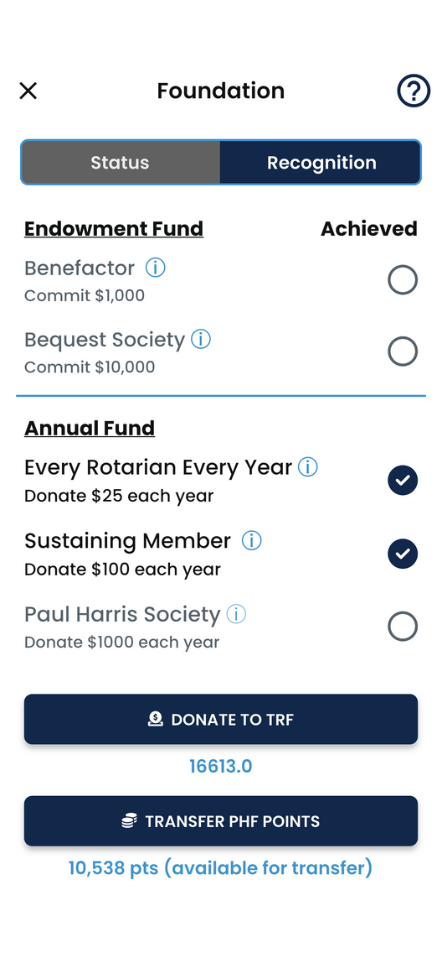
HOW TO GIVE THROUGH IGNITE

Slide 24
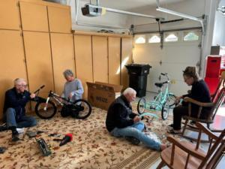
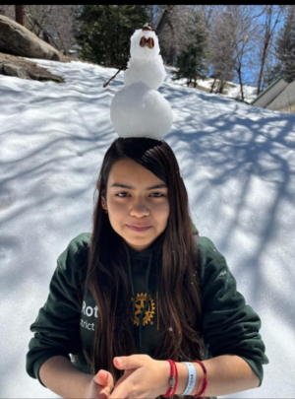
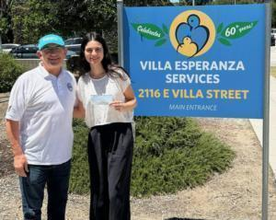
DISTRICT GRANTS
Key Aspects of District Grants:
Purpose: Fund short-term projects (local or international) focusing on Rotary's Seven Areas of Focus (e.g., clean water, education, health).
Funding Source: Derived from a district's District Designated Funds (DDF) from Rotary Foundation contributions.
Administration: Managed by the District's Foundation Committee, which distributes funds to qualifying clubs.
Club Eligibility: Often tiered based on a club's per capita contribution to the Annual Fund (e.g., higher giving gets more funding).
Project Scope: Generally smaller, quicker projects than Global Grants, with fewer restrictions and no matching funds needed.
Requirements: Clubs must attend a Grants Management Seminar, and follow reporting guidelines.

Slide 25
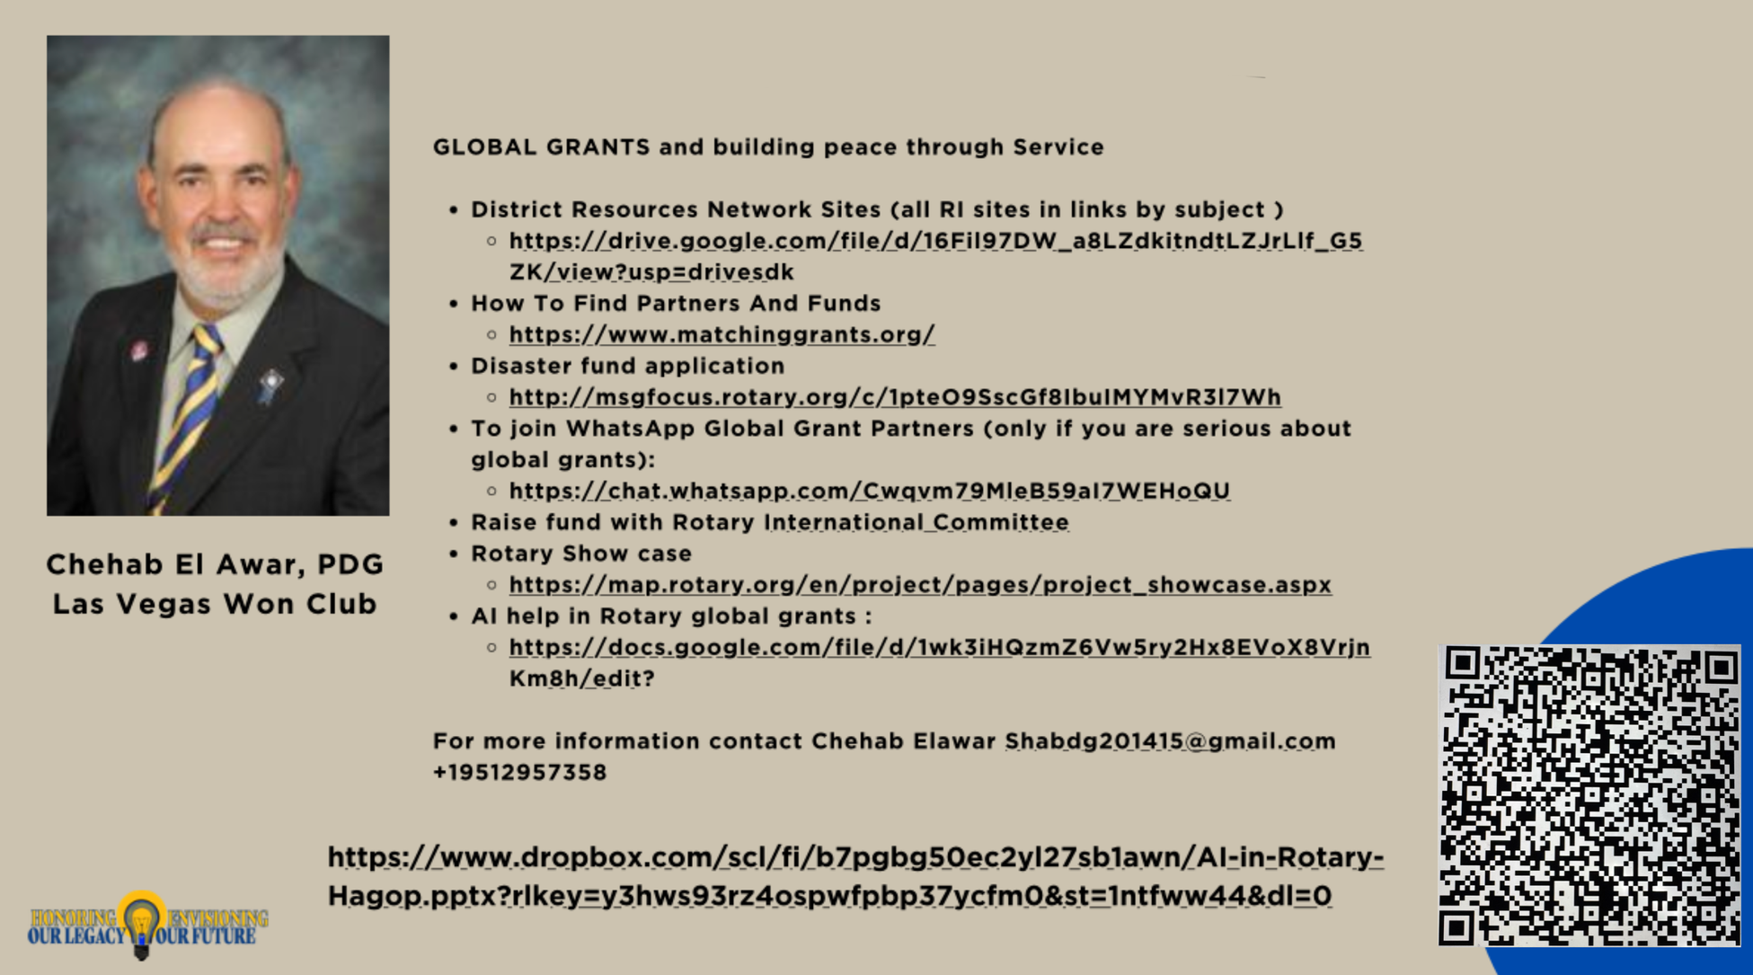
GLOBAL GRANTS

Slide 26
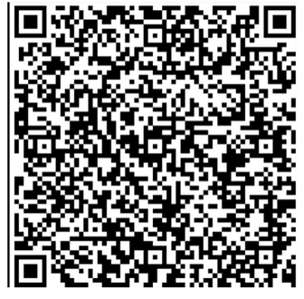
GLOBAL GRANTS
Basic global grants requirement
It has to be a minimum of $30,000.
It has to be between a club and another club or club in a district or Rotaract and a club.
You have to have 15% minimum from the international partner.
You have to have a community assessment
It has to be sustainable
It has to be in one of the areas of focus
You should have Rotaract and Rotary members involved
Our district will match up to 15,000 in DDF
You have to have one primary and three secondaries for each Global Grant
You have to have a separate bank account for each global grant with two signatures on the account
You have to file a progress report if the Grand is going to take over six months to finish
You can find a Global grant to participate in at matchinggrants.org
Contact Shab Elawar at 951-295-7358 shabdg201415@gmail.com

Slide 27

THANK YOU

