Slide 1


Vocational Service Essentials
Presented by 2025/26 Vocational Service Co-Chairs and Committee

Slide 2
Vocational Service encourages Rotarians to:
Practice high ethical standards in their professions and businesses
Recognize the dignity and value of all occupations
Use professional skills to serve their community
Help others develop their vocational skills, especially youth and emerging leaders
Notes:
Vocational Service encourages Rotarians to:
• Practice high ethical standards in their professions and businesses
• Recognize the dignity and value of all occupations
• Use professional skills to serve the community
• Help others develop their vocational skills, especially youth and emerging leaders
It’s rooted in Rotary’s belief that service happens not just through projects, but through our daily work.

Slide 3
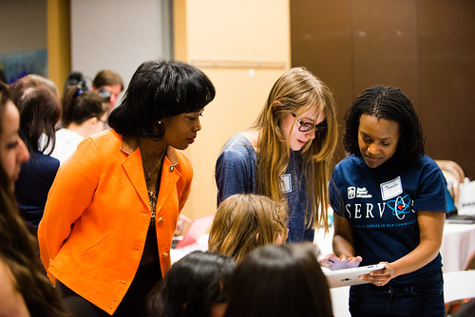
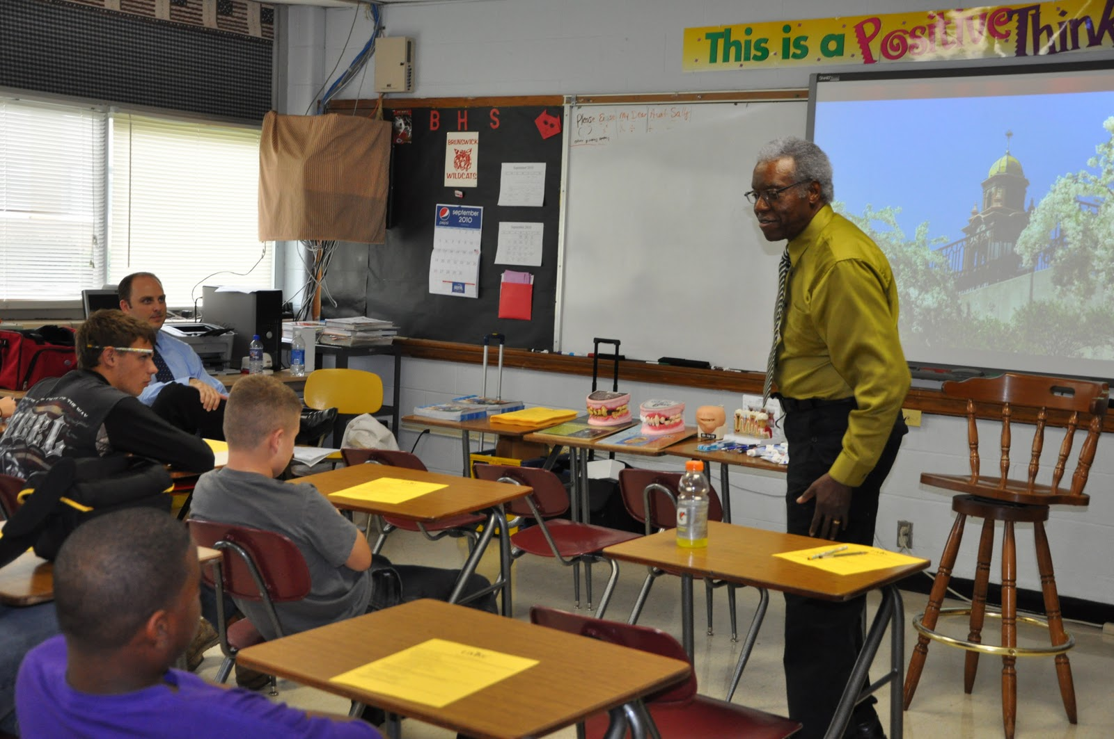

Notes:
Common examples of Vocational Service
• Mentoring students or young professionals
• Career days, mock interviews, and resume workshops
• Hosting job shadowing or internship opportunities

Slide 4
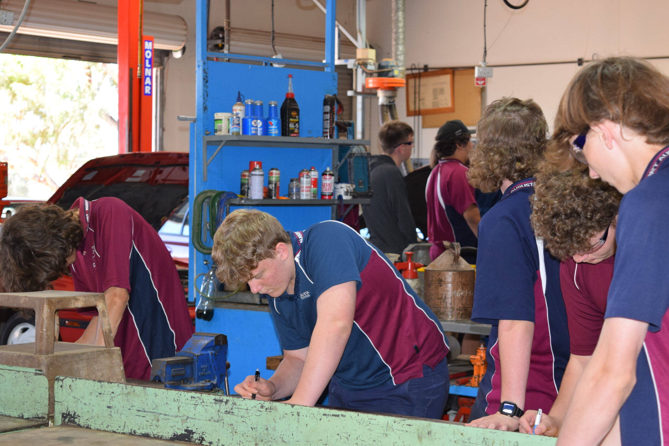

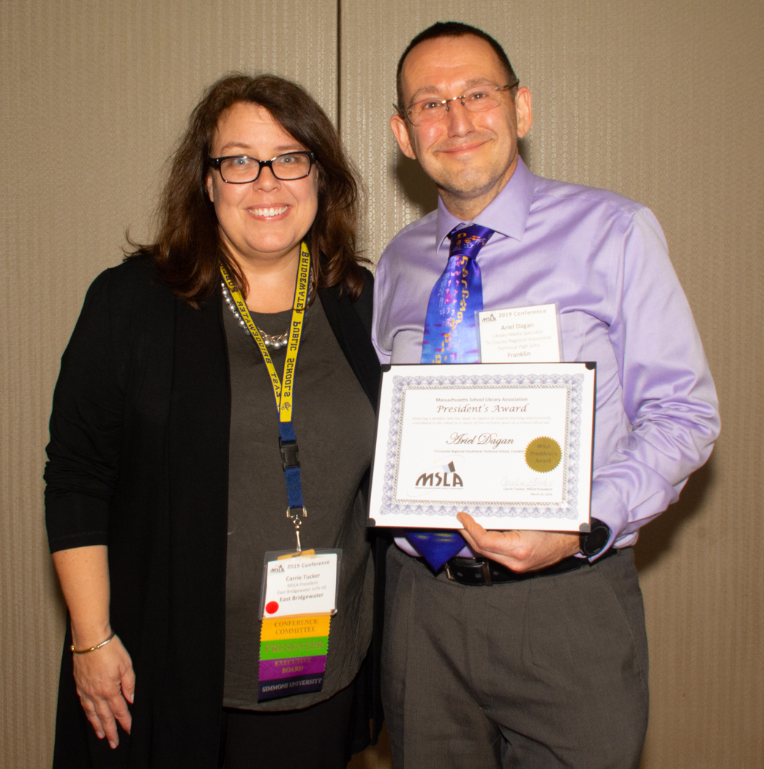
This Photo by Unknown Author is licensed under CC BY
Notes:
Supporting vocational training programs
Recognizing professionals through Vocational Service Awards
Living and promoting the Four-Way Test in business decisions

Slide 5

Why does Vocational Service matter?
Notes:
Vocational Service is what makes Rotary unique.
Unlike many service organizations, Rotary intentionally connects service with profession—reminding us that how we earn a living can also be how we serve humanity.

Slide 6


As Rotarians, we don’t leave our careers at the door – we bring them to the table for good!

Slide 7

Rotary Means Business Networking Events
This Photo by Unknown Author is licensed under CC BY-NC-ND

Slide 8

What IS Rotary Means Business?
Rotary Means Business encourages Rotarians to support the success of their fellow Rotarians by doing business with them and by referring others to them.
Notes:
* Rotary Means Business encourages Rotarians to support the success of their fellow Rotarians by doing business with them and by referring others to them.
These events allow us to connect to Rotarians across cities, areas, regions, districts, and BEYOND!
Attending can help you to
Grow your business.
Learn and adopt new technologies and SOPs for your business by networking with the great Rotary Leaders.
Make lasting connections.

Slide 9
Business Networking is the way forward and the future to build stronger relationships and acquire great customers.
Notes:
Business Networking is the way forward and the future to build stronger relationships and acquire great customers.

Slide 10
Attending RMB can help you to…
Grow your business,
Learn and adopt new technologies and SOPs for your business by networking with great Rotary Leaders, and
Make lasting connections!
Notes:
These events allow us to connect to Rotarians across cities, areas, regions, districts, and BEYOND!
Attending can help you to
Grow your business.
Learn and adopt new technologies and SOPs for your business by networking with the great Rotary Leaders.
Make lasting connections.

Slide 11

Questions? Contact: Paul Akin
CA/East & West paul.dnj@verizon.net (562) 577-6171

Slide 12

Questions?
Contact:
Dr. Stacey Wayman
High Desert
staceywayman719@gmail.com
615-596-6828

Slide 13

Las Vegas Area Networking Event
June 24th
Questions? Contact:
Dave Cabral
David@bfc.vegas
(702) 427-4769

Slide 14



Slide 15

Why a Business Plan Competition?
Notes:
Entrepreneurial literacy is essential for cultivating the next generation of small businesses, job creation, and community growth. Rotarians, with their business expertise and leadership, are uniquely positioned to inspire future entrepreneurs while offering students meaningful scholarship opportunities. This competition aligns with our vocational service mission by giving students a powerful first step on their vocational journey.

Slide 16

About the Competition…
High School Students (9 -12) – Individuals or Teams of up to 4 students
Students can access video resources to guide them with business plan creation.
Submit a written business plan
Judges review business plans. Clubs may have all contestants present or choose top 3 to compete.
Contestants present via Zoom or in –person to judging panel.
Clubs award winner and advance.
Notes:
High school students will compete at Club, Regional, and District level competitions by submitting written business plans and presenting their ideas before a judging panel.
Team Structure: Entries may be submitted by individuals or teams of up to 4 students.
Written Business Plan: All teams must submit a written plan for review at the Club level. Finalists from this stage will advance to oral presentations.
Oral Presentation: Selected finalists from the written portion will present their business plan in a
5–10-minute pitch, using PowerPoint, YouTube, or other presentation aids.
Presentation Format: Oral presentations may be conducted in-person or via video conferencing
(at the Club and Regional levels, at the discretion of the organizers).
Club Level Judge Panel: Each club will form a judges panel (non-Rotarians permitted):
Review and select finalists from the written business plans to provide oral presentations
Evaluate the oral presentations
Select one winner to advance to the Regional Competition Level to represent their club

Slide 17

Awards and Recognition
Club Level Prizes – at the club’s discretion
Regional Level Prizes – 1st Place $500, Runner-Up $250, All other competitors receive $125 consolation prize
District Level Prizes – 1st Place $2,000 + $300 to supporting teacher; 2 Runners Up $500 each + $100 to supporting teachers – All District Finalists to receive District 5300 Certificates of Excellence.
Notes:
Awards & Recognition [subject to change based on number of clubs participating]
Cash prizes will be awarded during both the Regional & District level competitions.
Club Level Prizes: At club discretion
Regional Level Prizes: 1st place $500; Runner-Up $250; All other competitors to receive a $125 Consolation Prize.
District Finals Prizes: 1st place $2,500; 2nd place $1,000; 3rd place $500; 4th place $500
All Finalists: Receive District 5300 Certificates of Excellence and commendations from U.S. Congressional Representatives and California or Nevada State Assembly members (depending on school location)

Slide 18

Tools and Resources…
Business Plan Outline – covers basics of writing business plan and crafting strong proposals
Scoring Sheet Templates – for both written and oral presentations to ensure consistent judging
Promotional Flyers – to assist with marketing and encourage participation
Business Plan Advisor SMHS Courtney Rushing crushing@smusd.us
Notes:
To support clubs and students, we will provide:
A Business Plan 101 Workshop Recording covering the basics of business planning and guidance on crafting strong proposals
Scoring sheet templates to assist with consistent judging.
Promotional flyers to help your club market and encourage participation in the competition.

Slide 19
Vocational Committee Co-Chairs
Contact us with questions AND to join the committee!
  David Cabral – Nevada – David@bfc.vegas (702) 427-4769
  Paul Akin – CA/East & West – paul.dnj@verizon.net (562) 577-6171
  Dr. Stacey Wayman – CA/High Desert – staceywayman719@gmail.com (615) 596-6828

Slide 20

Questions?

Slide 21
Thank You!

